Slide 1


YEAR 1
Weight & Volume
Introduce weight and mass
Measure mass
Compare mass
Block 4 – Week 10

Slide 2

Lesson 1
Step: Introduce weight and mass
(Practical)

Slide 3
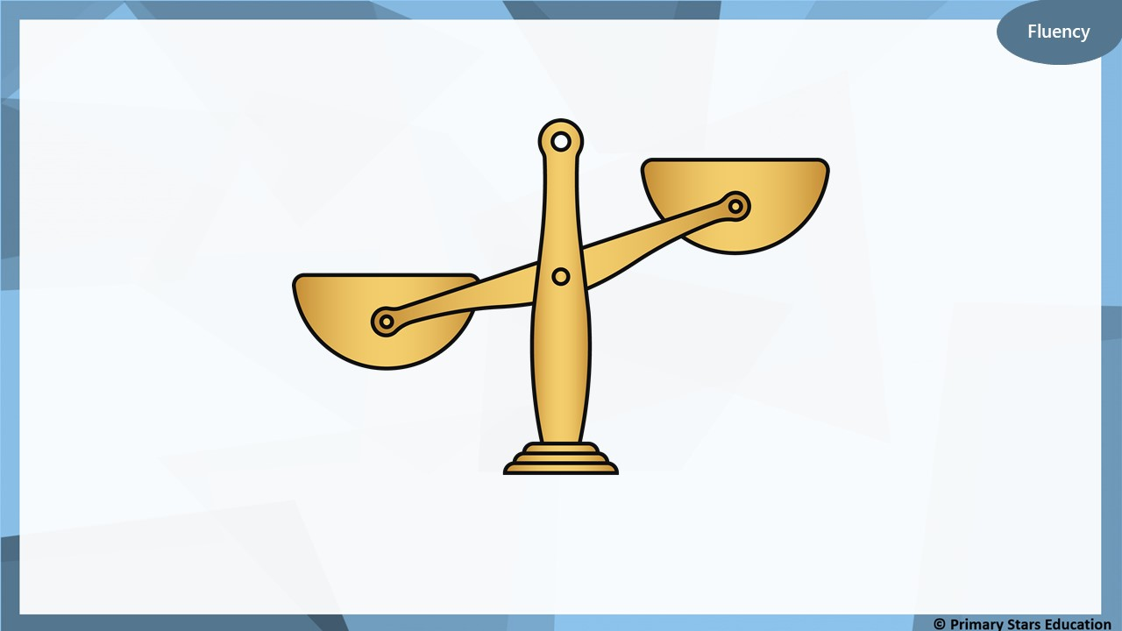
What does it mean when the scale is down?
It means it has the heavier object on that side.

Slide 4
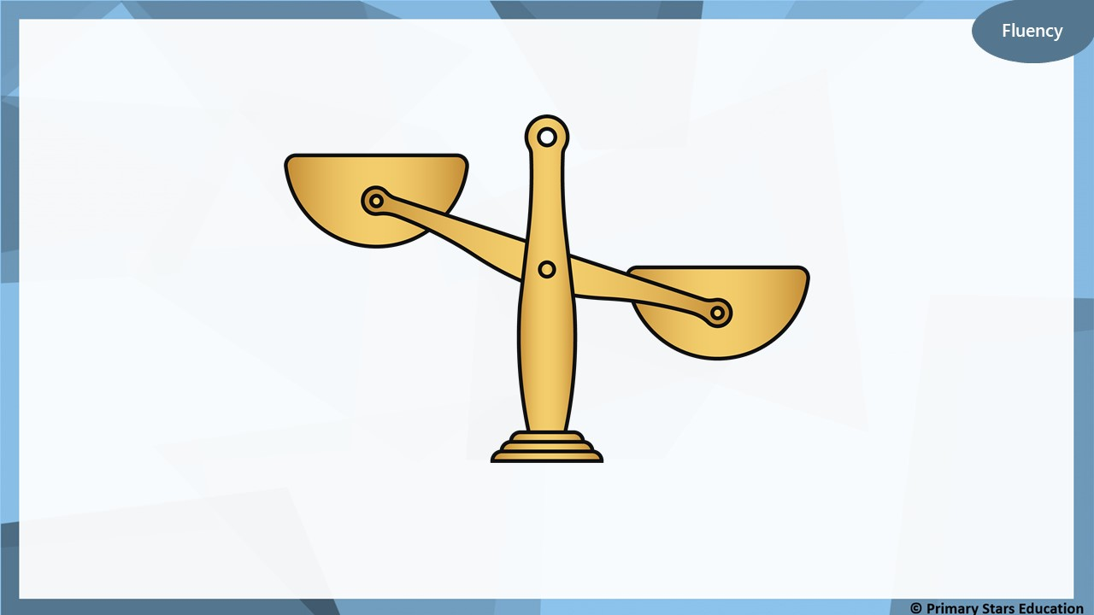
What does it mean when the scale is up?
It means it has the lighter object on that side.

Slide 5
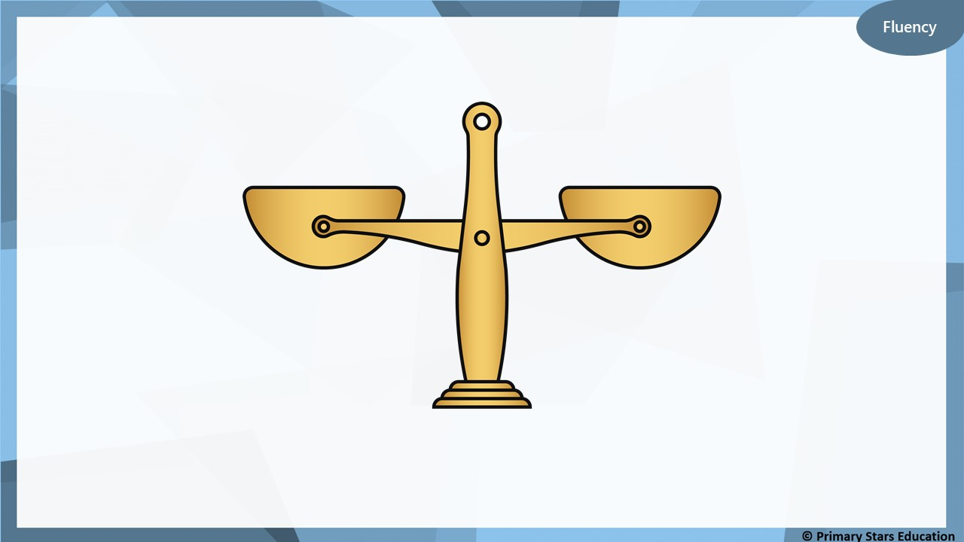
What does it mean when the scales are balanced?
It means both items on the scale have the same mass.

Slide 6
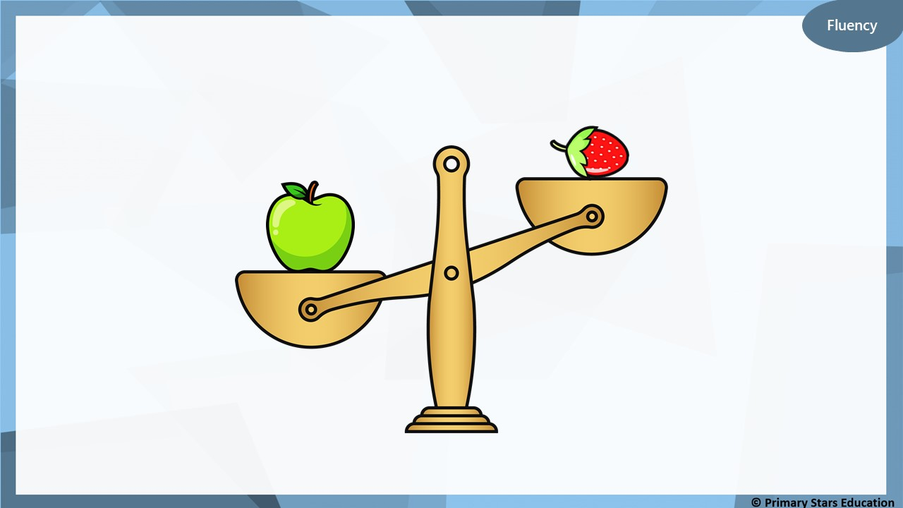
Which object is heavier? ____________________
Which object is lighter? ____________________
the apple
the strawberry
How do you know?

Slide 7
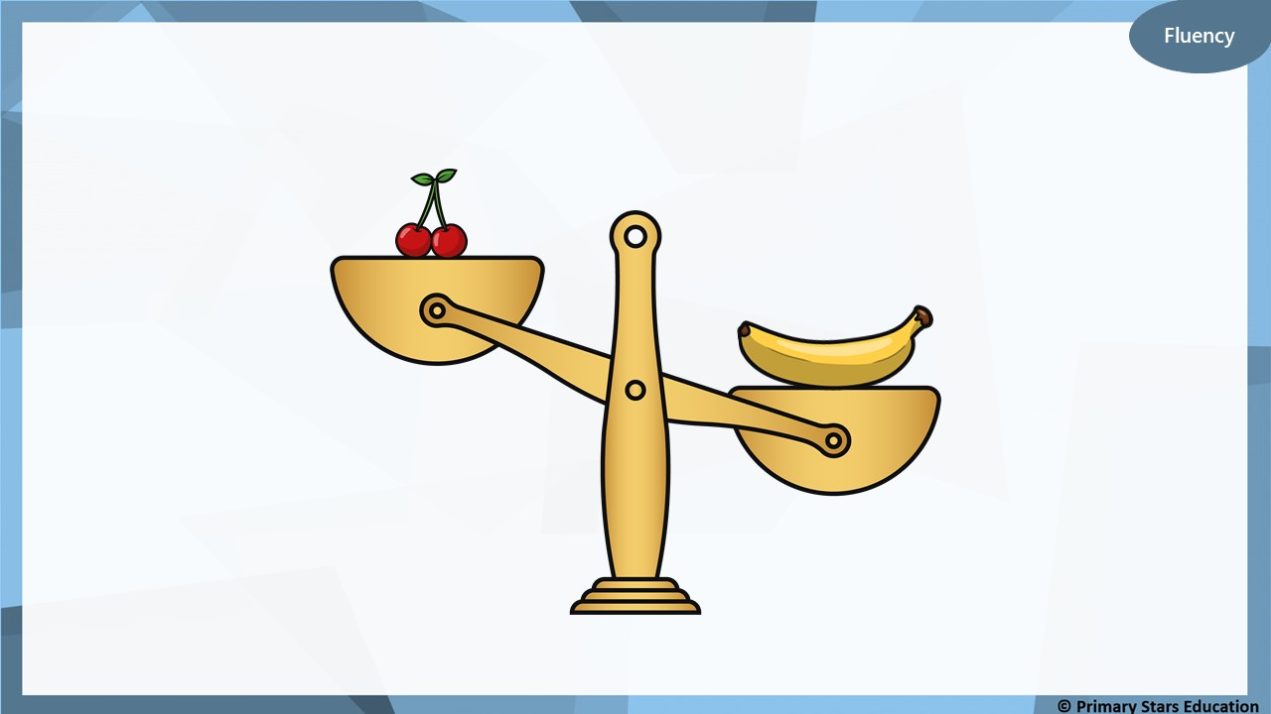
Which object is heavier? ____________________
Which object is lighter? ____________________
the banana
the cherry
How do you know?

Slide 8
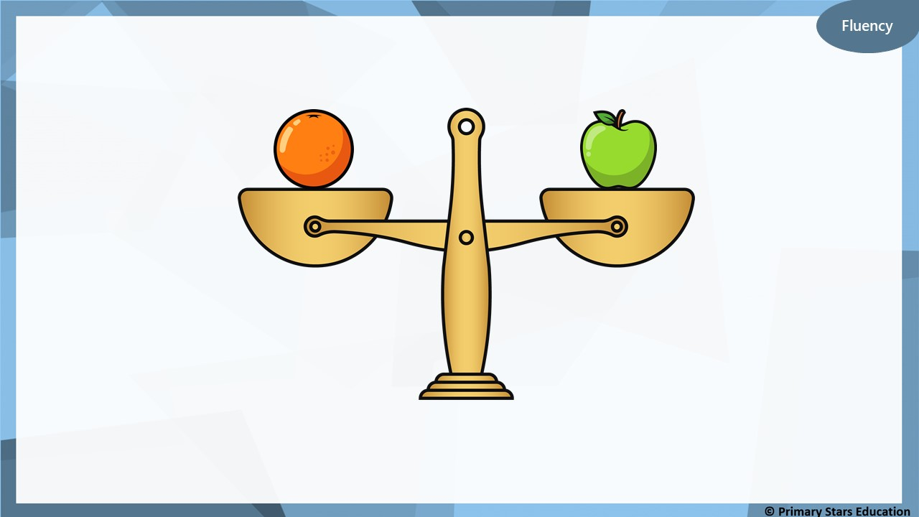
What do the balance scales show?
The balance scales show that the apple and orange
weigh the same.

Slide 9
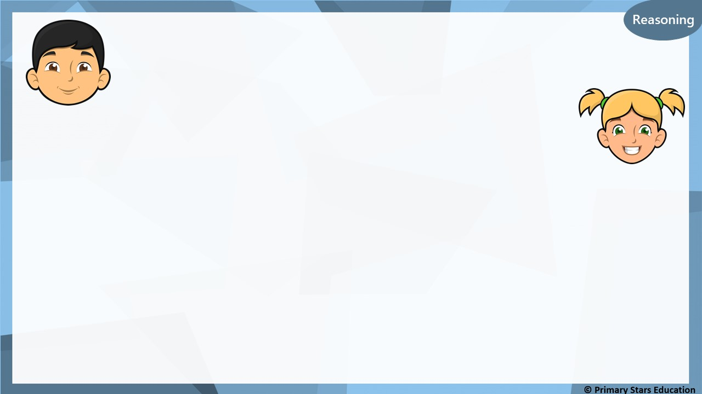

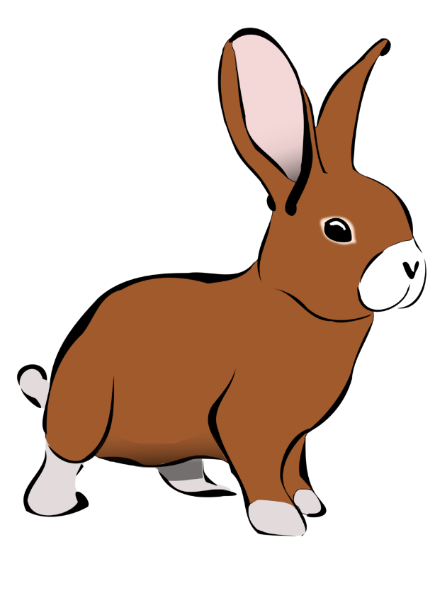
Reasoning
The light bulb is heavier than the rabbit.
Che
The rabbit is heavier than the light bulb.
Kat
Who is correct? Explain your answer.
Kat is correct. The rabbit weighs more than the light bulb.

Slide 10
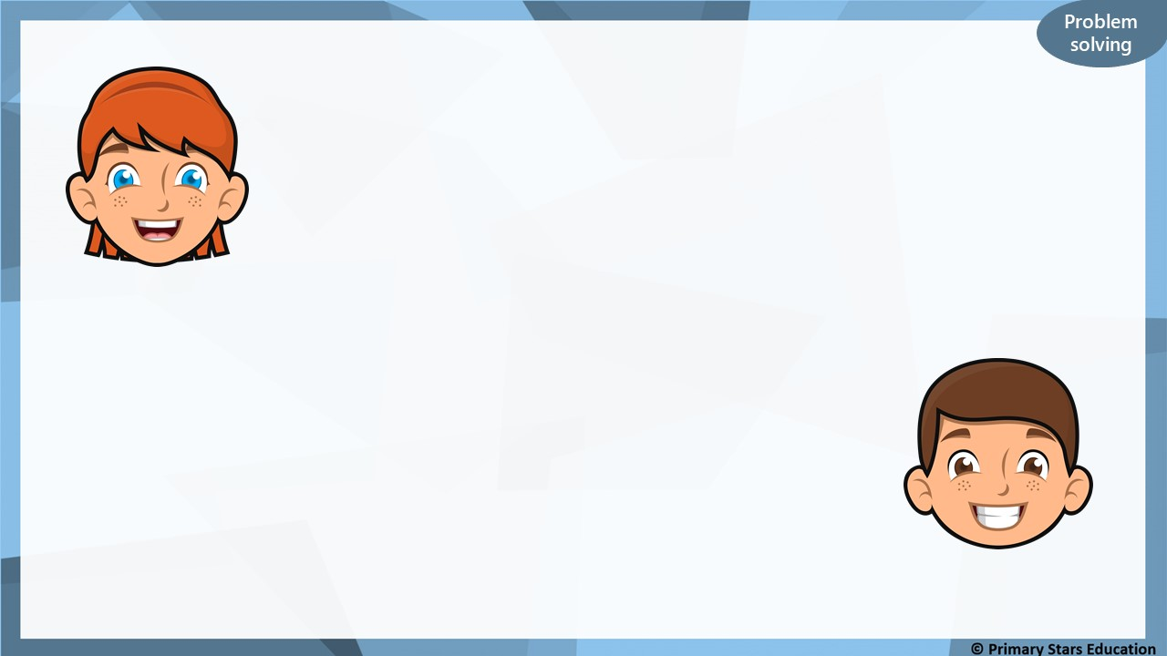


Name three items that are lighter than a football.
Name three items that are heavier than a book.

Slide 11
Lesson 2
Step: Measure mass
(Practical)

Slide 12
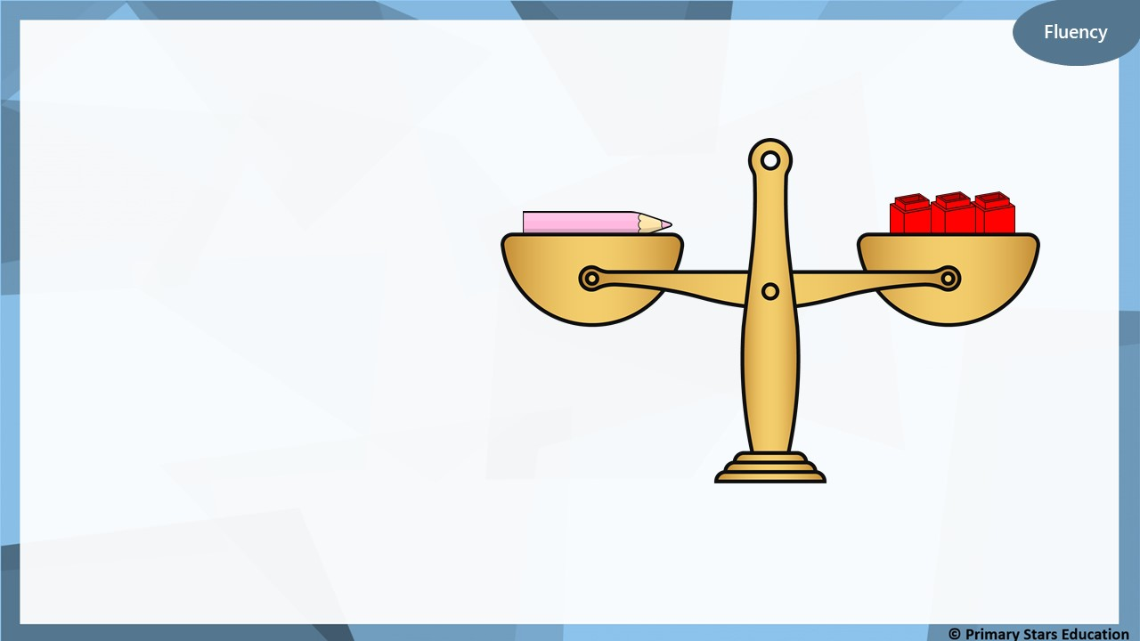
In this lesson you are going to weigh different items
using cubes.
Estimate
Measure
Write a sentence:
The __________ weighs the same as ____ cubes

Slide 13
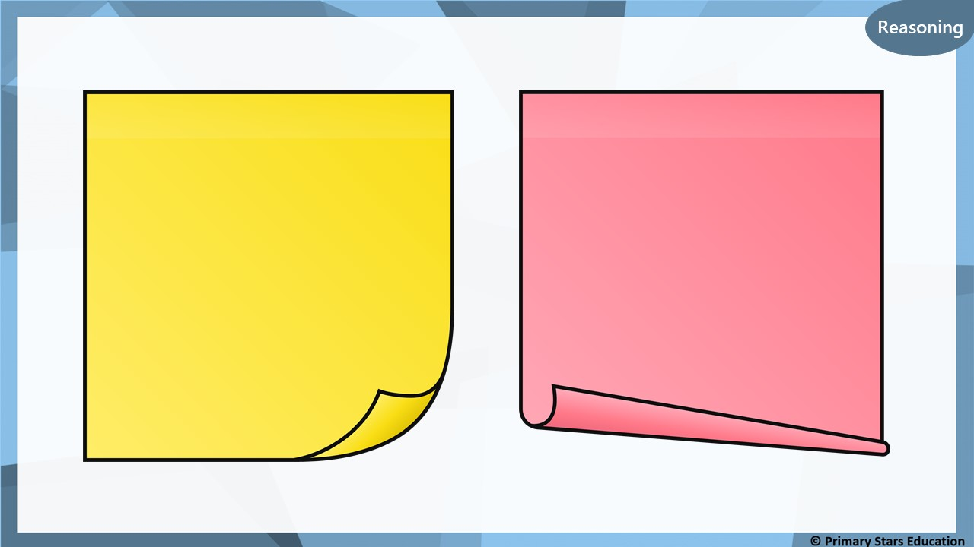
Is the biggest item always the heaviest item?
How do you know?
How many cubes in difference is the heaviest item and lightest item?

Slide 14
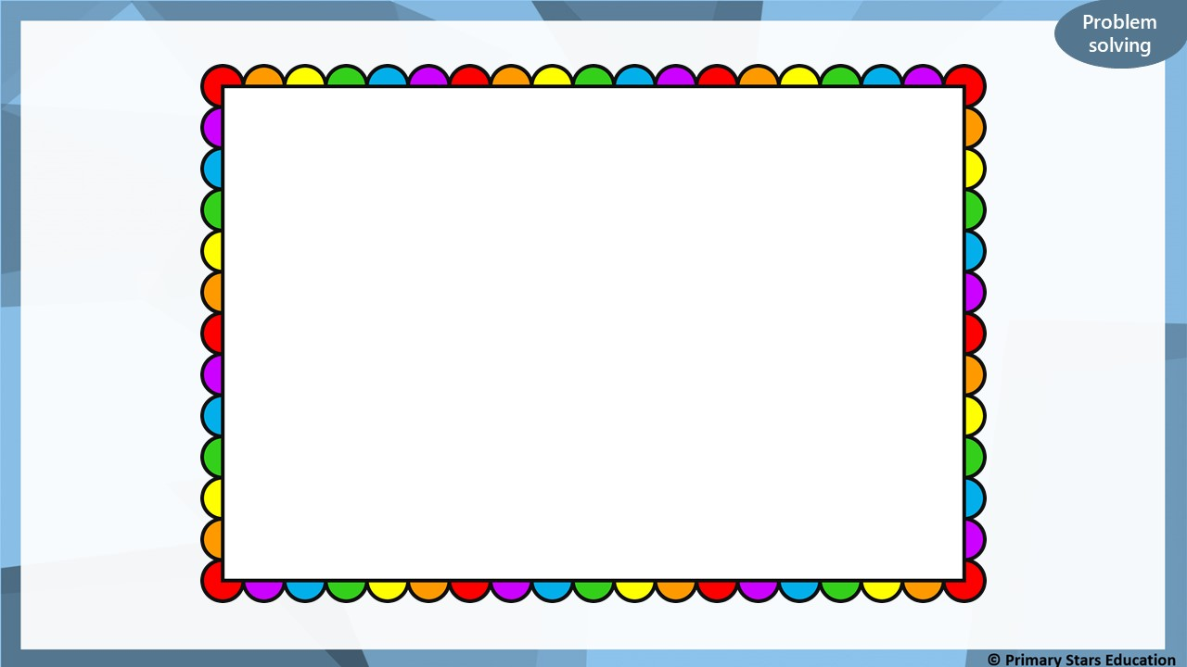
Think of three of your own
questions to ask your
partner about the objects
you have weighed.

Slide 15
Lesson 3
Step: Measure mass

Slide 16
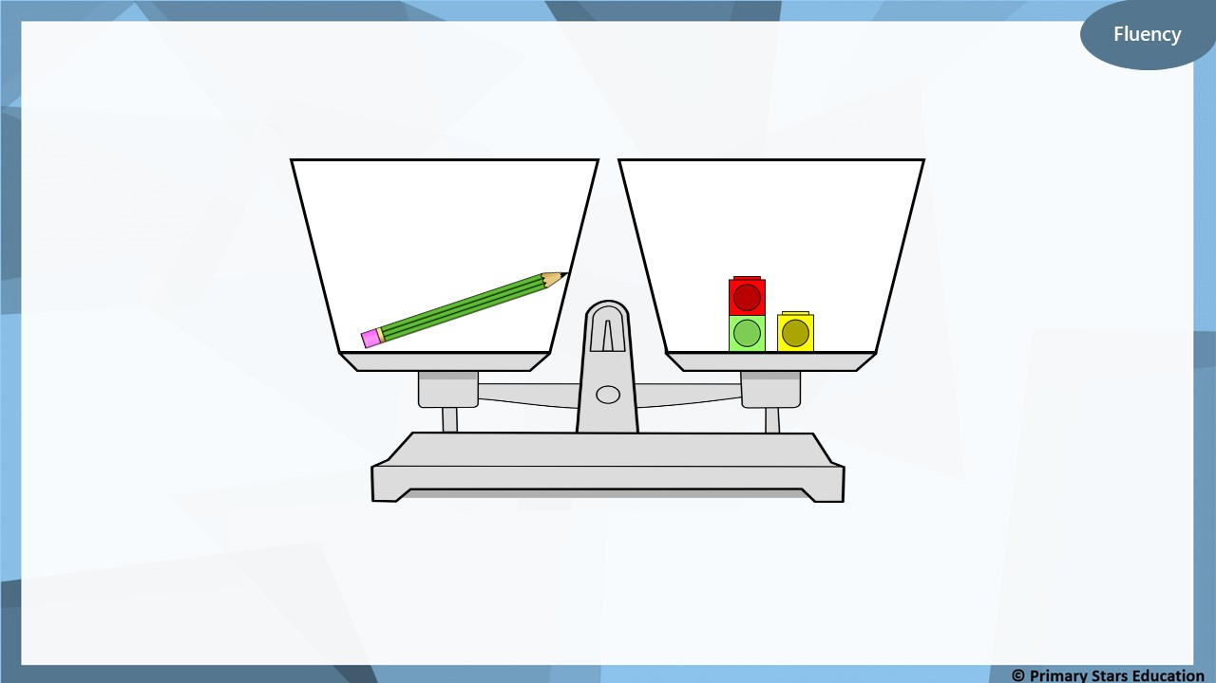
How many cubes does pencil weigh?
3 cubes
How do you know?
What would happen if we removed a cube?

Slide 17
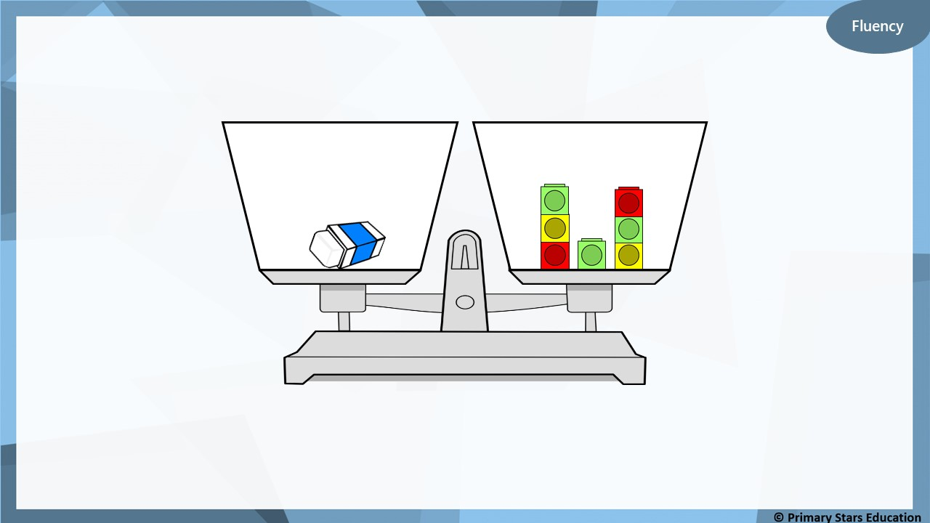
How many cubes does rubber weigh?
7 cubes
How do you know?
What would happen if we added a cube?

Slide 18
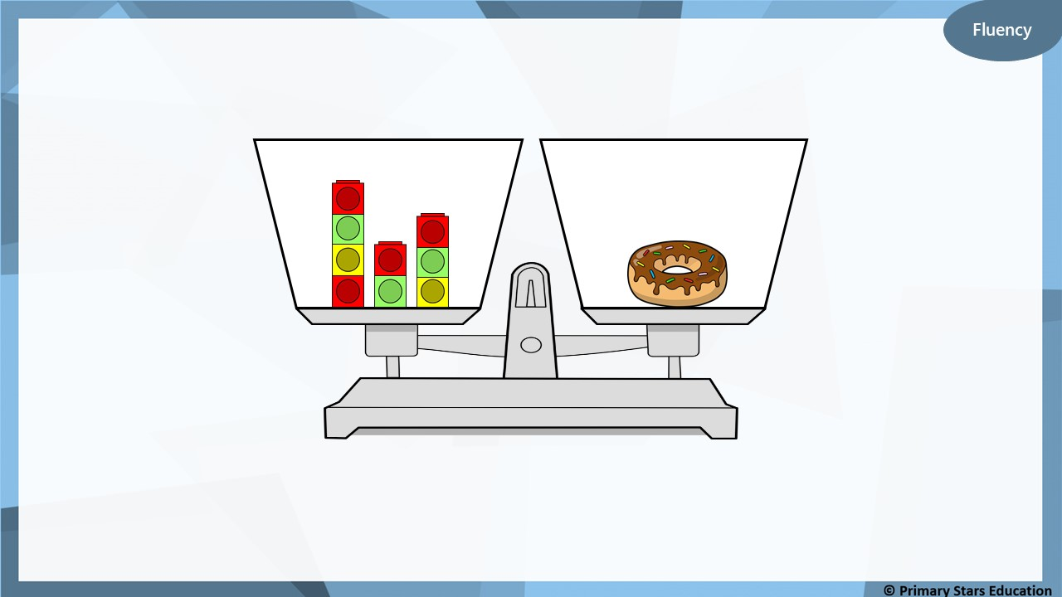
How many cubes does doughnut weigh?
9 cubes
How do you know?
What would happen if we added another doughnut?

Slide 19
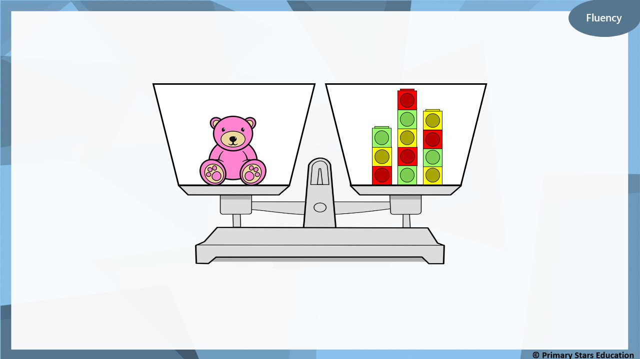
How many cubes does teddy weigh?
12 cubes
How do you know?
What would happen if we removed 3 cubes?

Slide 20
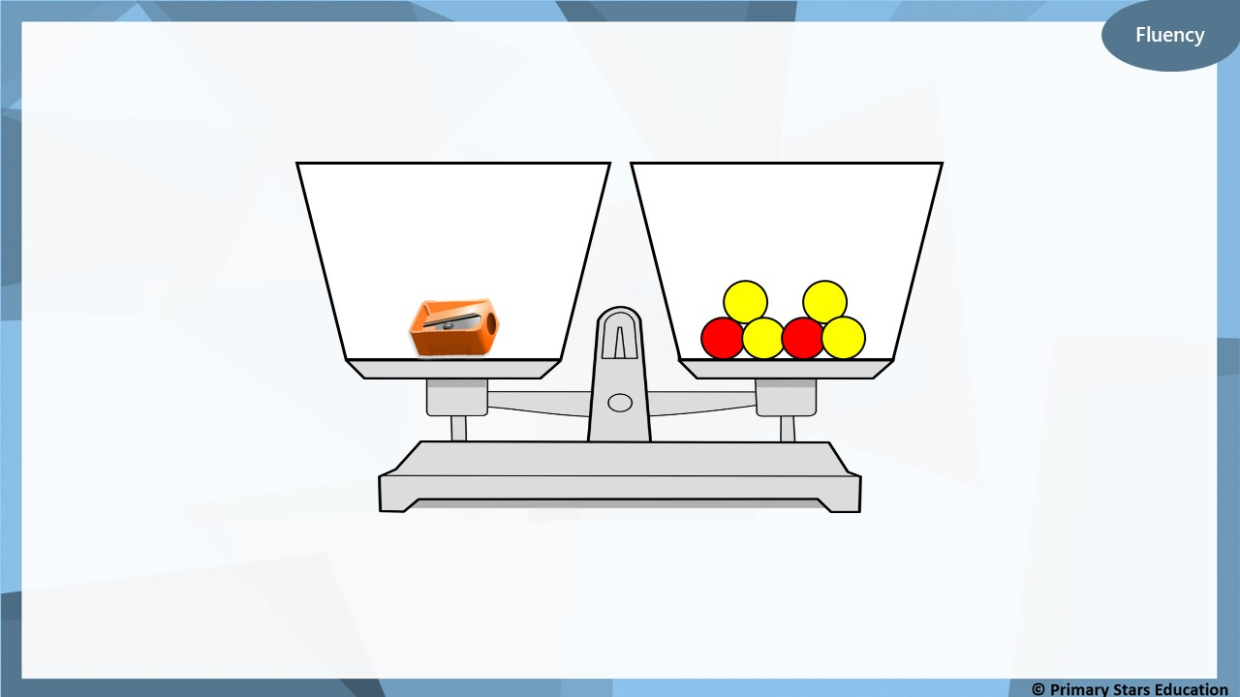
How many counters does sharpener weigh?
6 counters
How do you know?
What would happen if we added another sharpener?

Slide 21
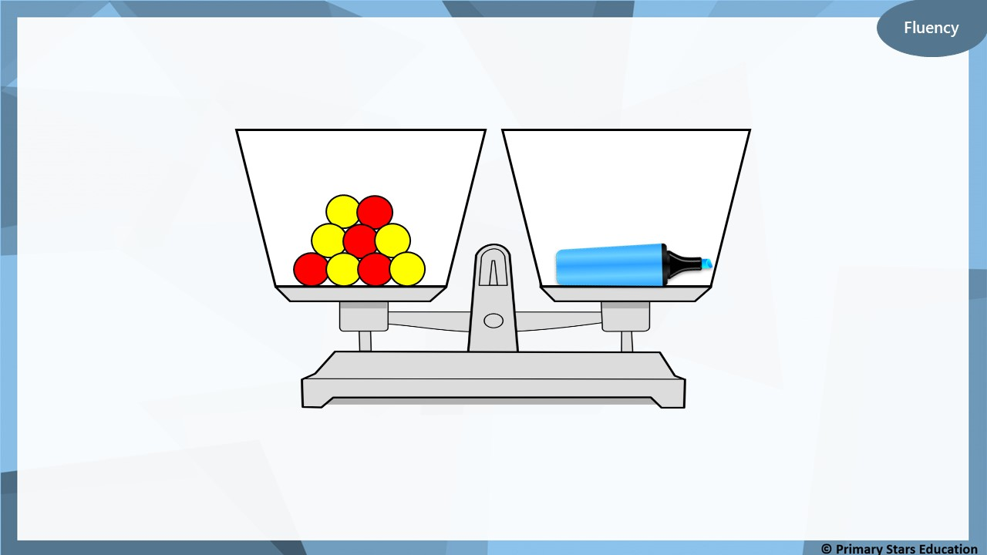
How many counters does highlighter weigh?
9 counters
How do you know?
What would happen if we removed 2 counters?

Slide 22
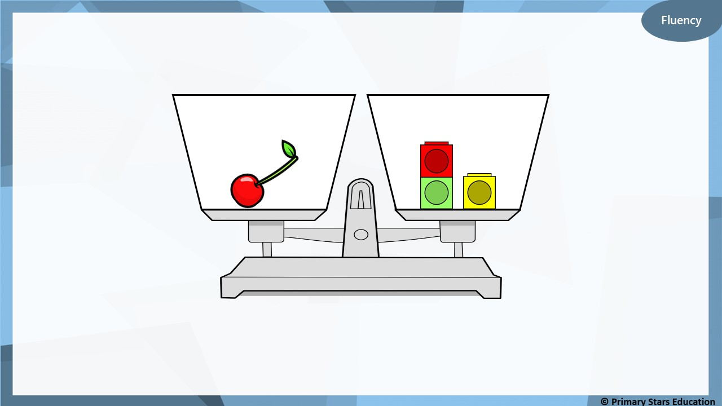
Write a sentence to describe the mass of the object.
The cherry weighs 3 cubes.

Slide 23
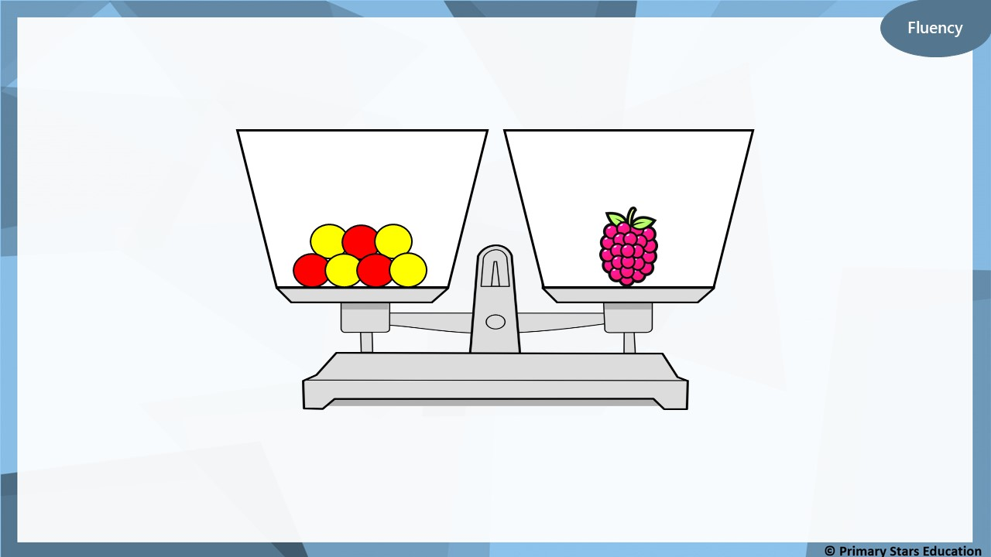
Write a sentence to describe the mass of the object.
The raspberry weighs 7 counters.

Slide 24
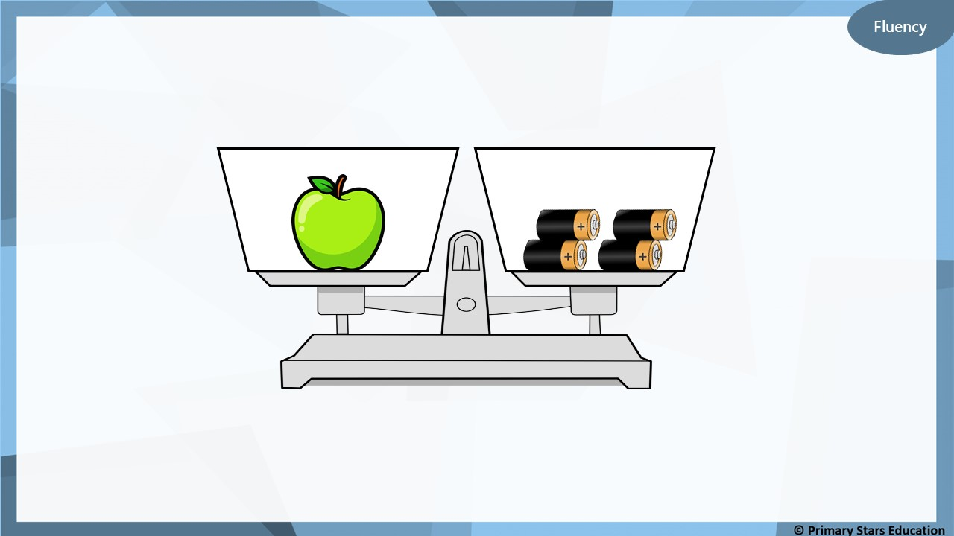
The apple’s mass is measured using batteries.
The pear is lighter than the apple.
What could the pear weigh?
1, 2 or 3 batteries.

Slide 25
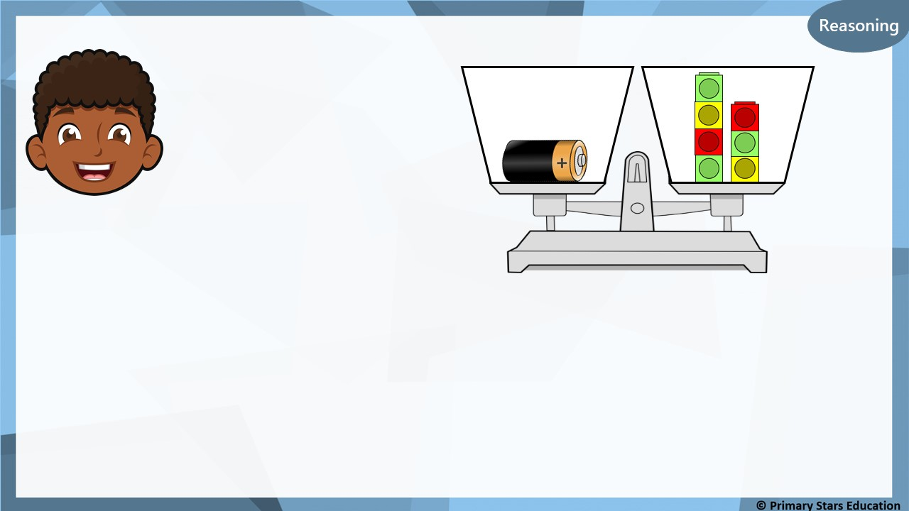
Reasoning
The battery weighs less than 8 cubes.
Is Dom correct?
Explain how you know.
Dom is correct.
The battery weighs 7 cubes.
7 is less than 8.

Slide 26
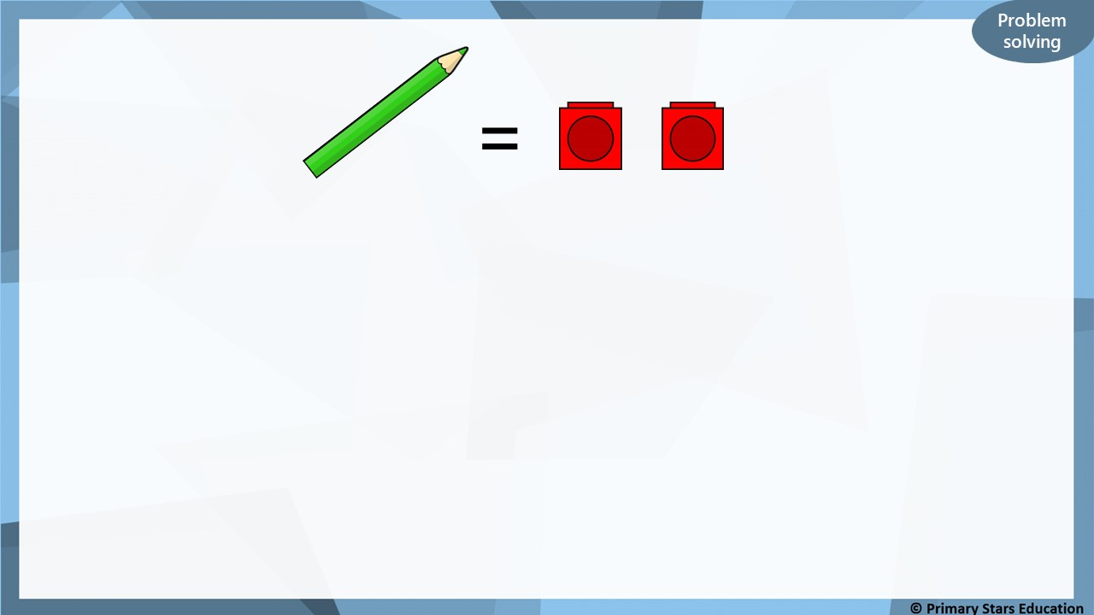
4 cubes
What do 2 pencils weigh? _______________
What do 3 pencils weigh? _______________
What do 4 pencils weigh? _______________
6 cubes
8 cubes
Do you notice a pattern?

Slide 27
Lesson 4
Step: Compare mass

Slide 28
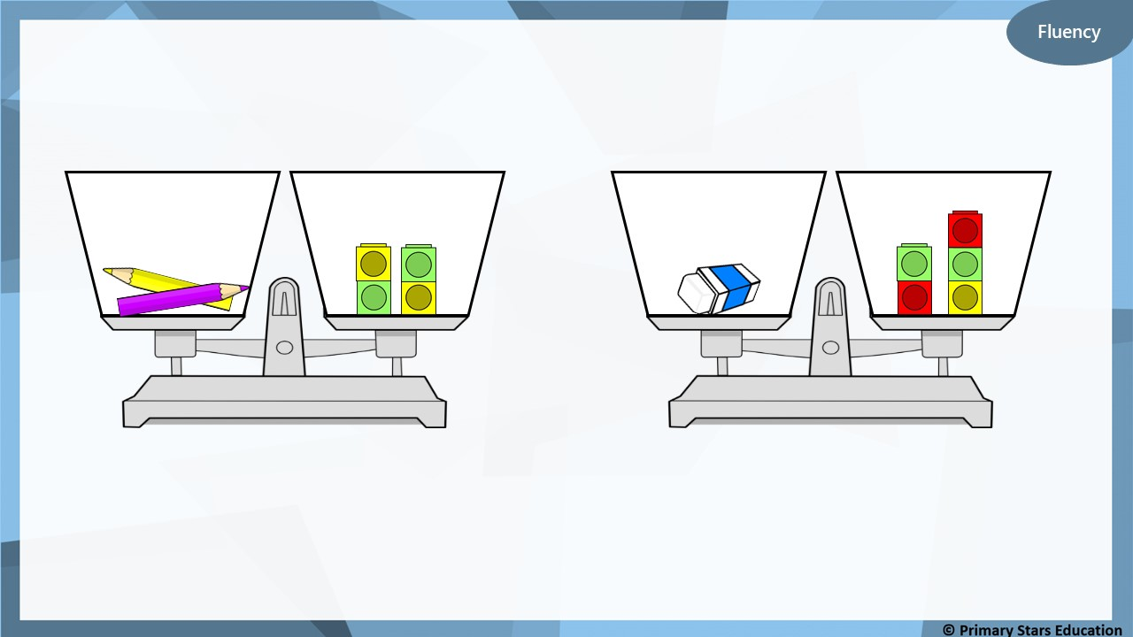
the rubber
Which item is heavier? ___________________
How do you know?

Slide 29
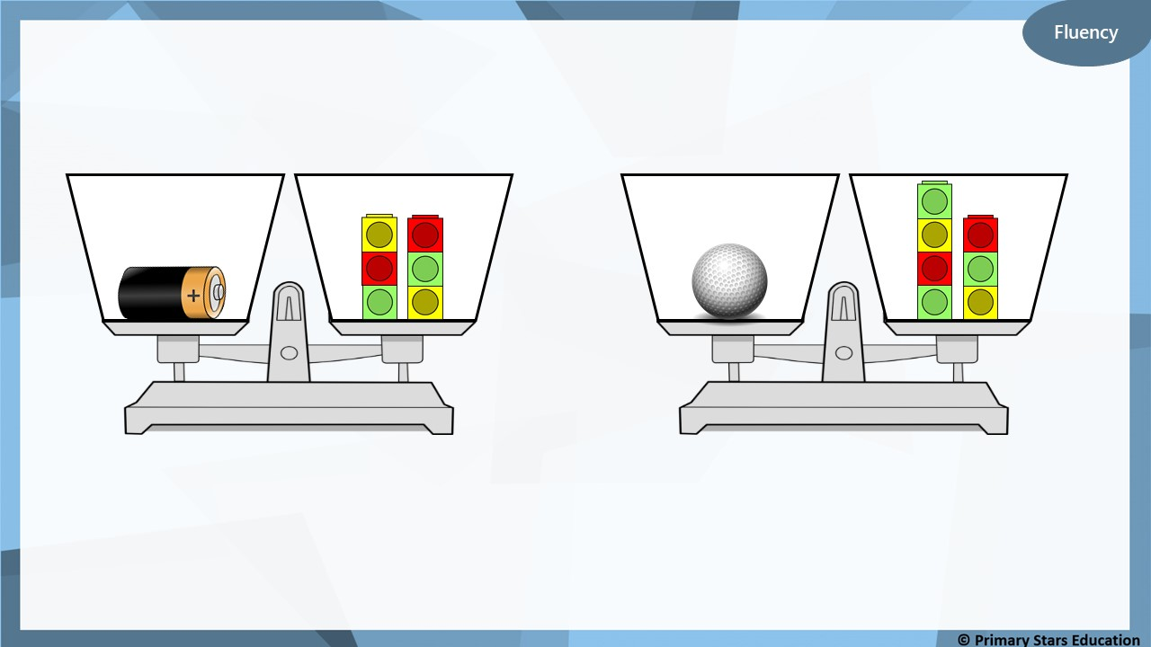
the golf ball
Which item is heavier? ___________________
How do you know?

Slide 30
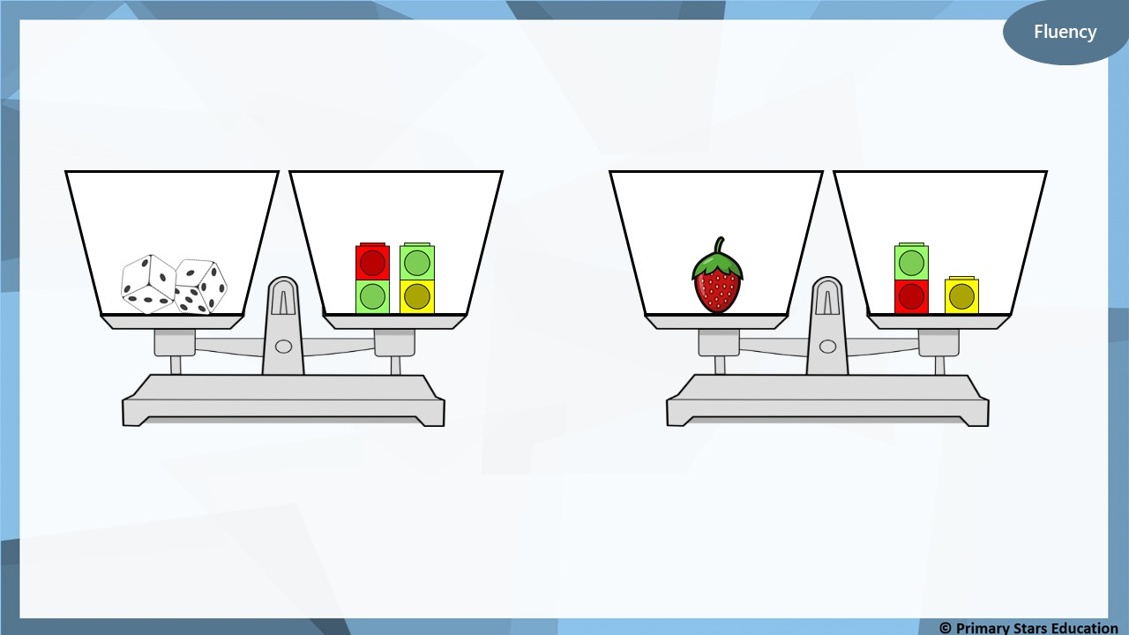
the dice
Which item is heavier? ___________________
How do you know?

Slide 31
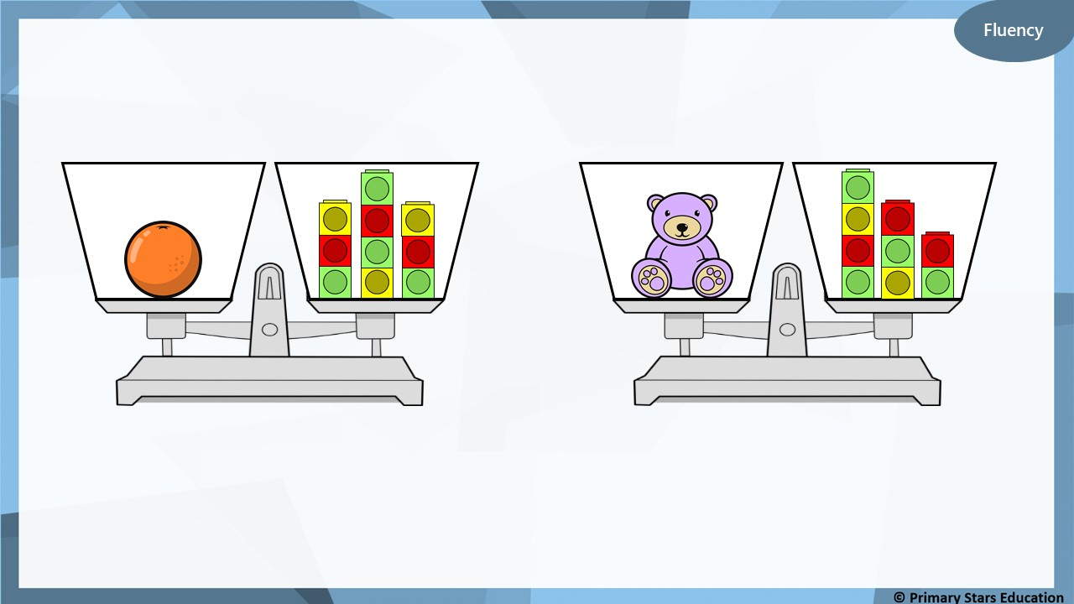
the teddy
Which item is lighter? ___________________
How do you know?

Slide 32
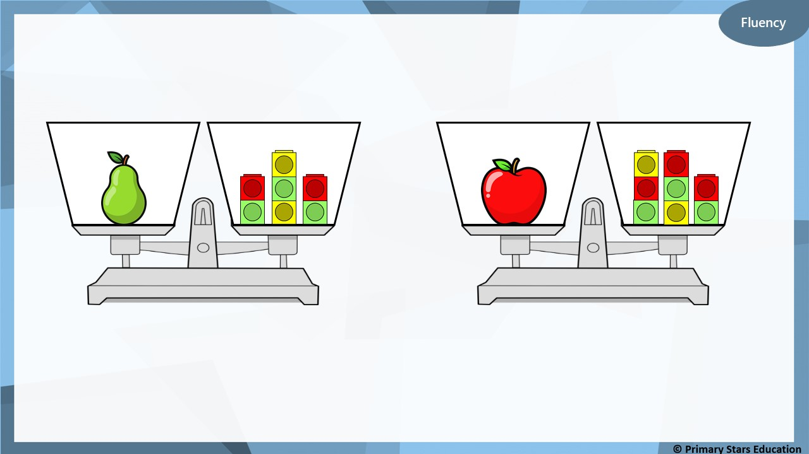
the pear
Which item is lighter? ___________________
How do you know?

Slide 33
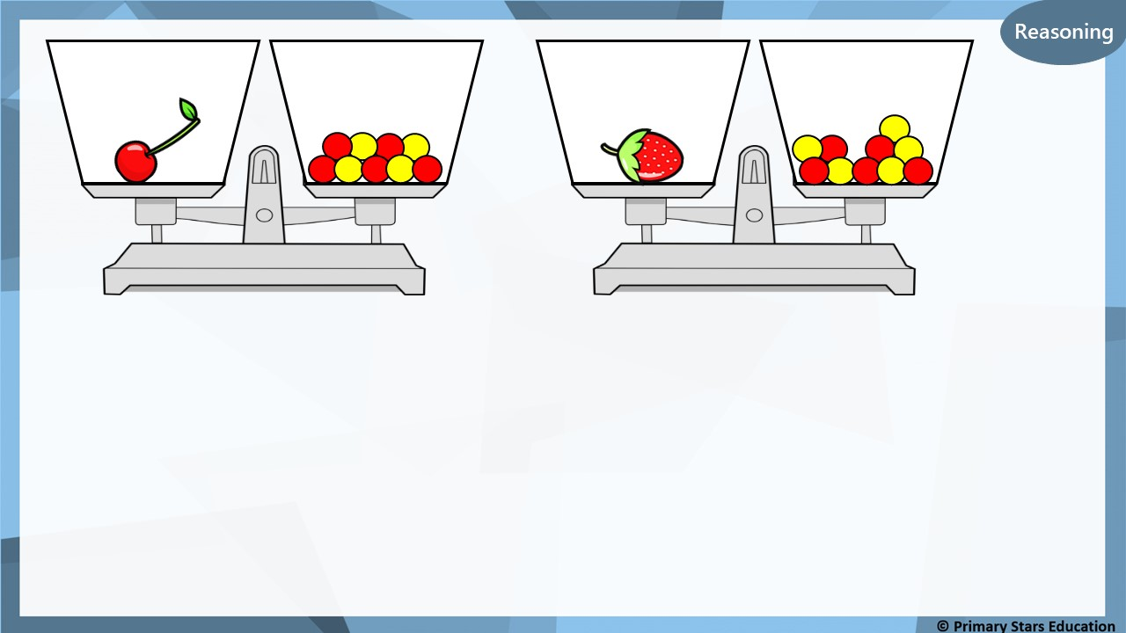
The cherry weighs more than the strawberry.
True or false? Explain your answer.
False.
The cherry weighs 9 counters and strawberry weighs 10.

Slide 34
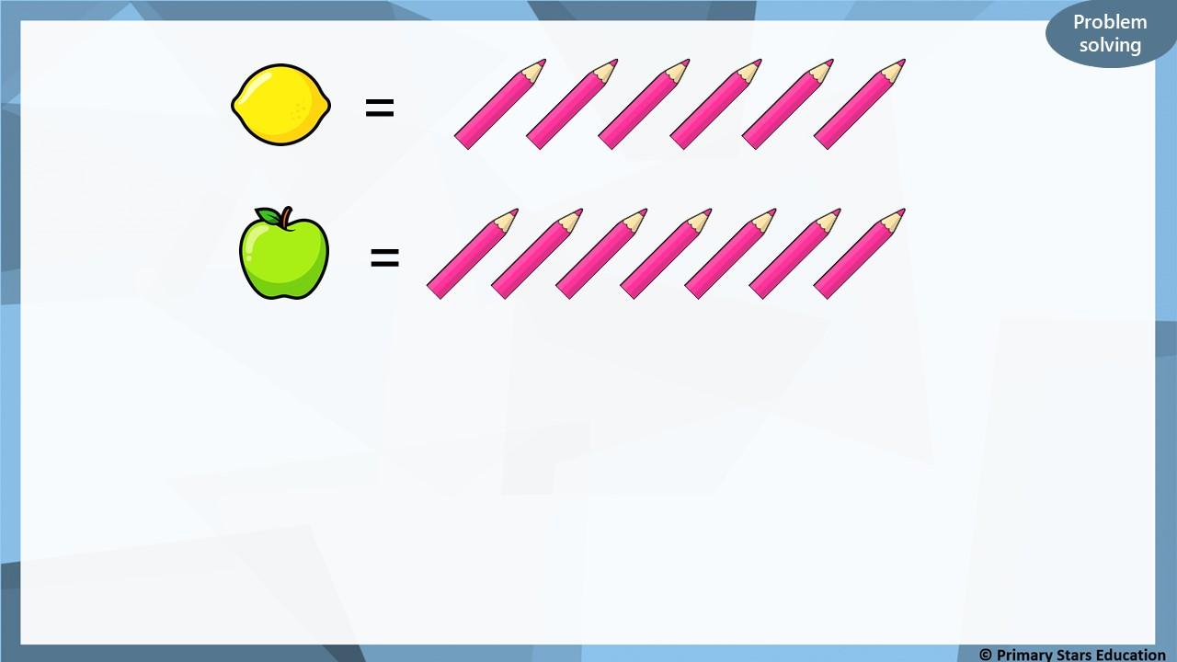
apple
The _____________ is the heaviest.
The _____________ is the lightest.
The _____________ weighs ____ pencils.
The _____________ weighs ____ pencils.
lemon
apple
7
lemon
6

