Slide 1
Tuesday 12th May
WALT: Understand and calculate scale factors

Slide 2

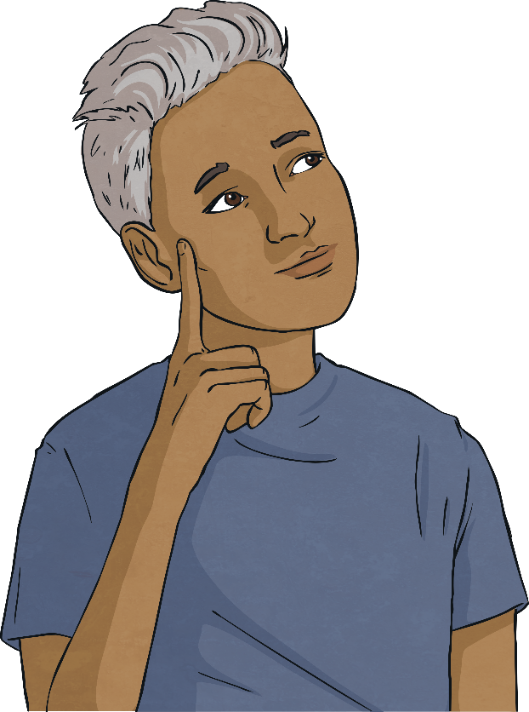
Using Scale Factors
Diving
This rectangle has been doubled in size.
a)
Which are the correct representations of this?
b)
c)

Slide 3
Using Scale Factors
Diving
Shape A has been enlarged by a scale factor of 2.
B
A
4cm
7cm
Not to scale
What are the new dimensions of Shape B?
Width: 9cm
Height: 8cm
Width: 9cm
Height: 6cm
Width: 14cm
Height: 8cm

Slide 4
Using Scale Factors
Diving
The rectangle has been enlarged by a scale factor of 3.
Calculate the perimeter of the original shape.
Not to scale
5cm by 3cm are the dimensions of the original shape.
Dividing each dimension by 3 helps to solve this problem.
9cm
9cm ÷ 3 = 3cm
15cm ÷ 3 = 5cm
5cm + 5cm + 3cm + 3cm = 16cm
15cm
perimeter = 16cm

Slide 5


Using Scale Factors
Deeper
Shape A has been enlarged by a scale factor of 3 to create shape B.
B
A
Do you agree with Ronda? Explain how you know.
Ronda is incorrect. Although the width of the shape has increased from 1 square to 3, the height of the shape should be 6 squares (not 4) if enlarged by a scale factor of 3.

Slide 6
Using Scale Factors
Deeper
This regular hexagon has been enlarged by a scale factor of 2.
What was the perimeter of the original shape?
7cm
Not to scale
7cm ÷ 2 = 3.5cm
The original regular hexagon had sides measuring 3.5cm in length.
6 × 3.5cm = 21cm
perimeter of original hexagon = 21cm

Slide 7
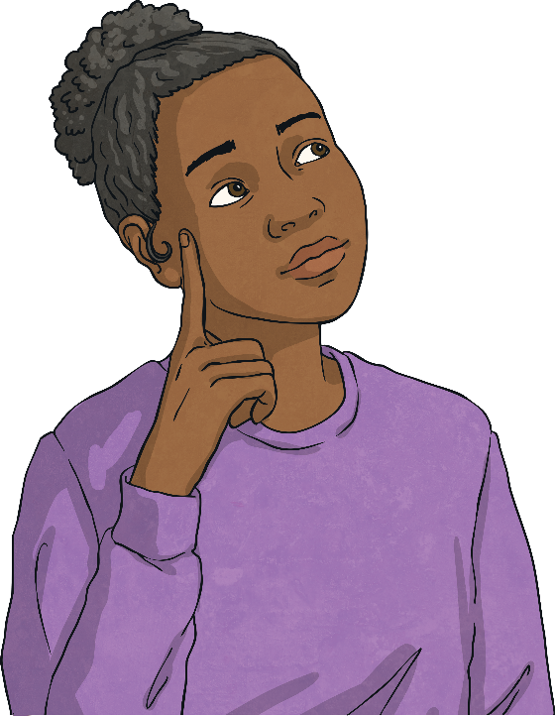
Using Scale Factors
Deeper
Do you agree with Holly? Explain how you know.
5cm
If I enlarge the shape by a scale factor of 4, the new area will be 280cm².
9cm
5 x 4 = 20cm
9 x 4 = 36cm
area = 36 x 20 ÷ 2 = 360cm²
Holly is incorrect.

Slide 8


Using Scale Factors
Deepest
Both triangles are equilateral triangles.
B
A
Do you agree with Jeni or Katya?
Use reasoning to explain your answer.
3.5cm
7cm
The perimeters of both shapes are even and triangle B is an enlargement of triangle A by scale factor 2.
None of the perimeters are even and triangle B is an enlargement of triangle A by scale factor 2.
Jeni
Katya

Slide 9
Using Scale Factors
Deepest
The yellow rectangle is an enlargement of the blue rectangle. The blue rectangle has a perimeter of 10cm. Work out the perimeter of the yellow rectangle.
2cm
12cm
The blue rectangle is 2cm x 3cm.
The side that is 3cm has been enlarged by a scale factor of 4 to give 12cm.
Therefore, the yellow rectangle is 12cm x 8cm.
The perimeter of the yellow rectangle is 40cm.

Slide 10


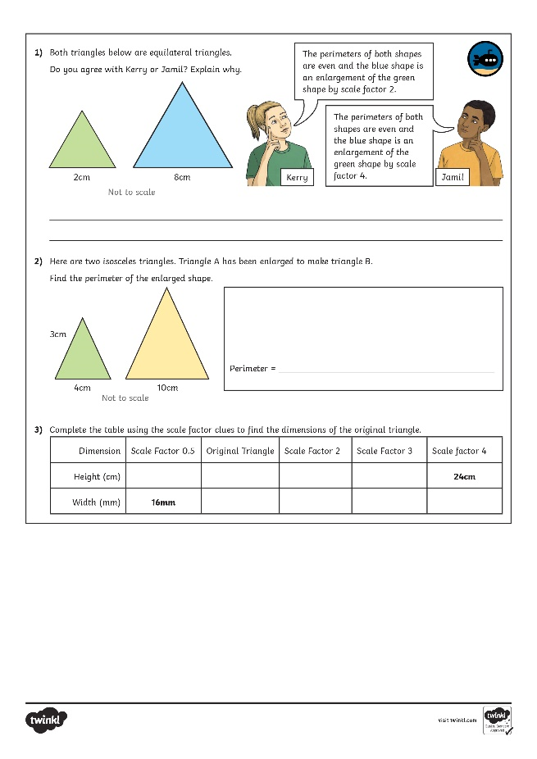
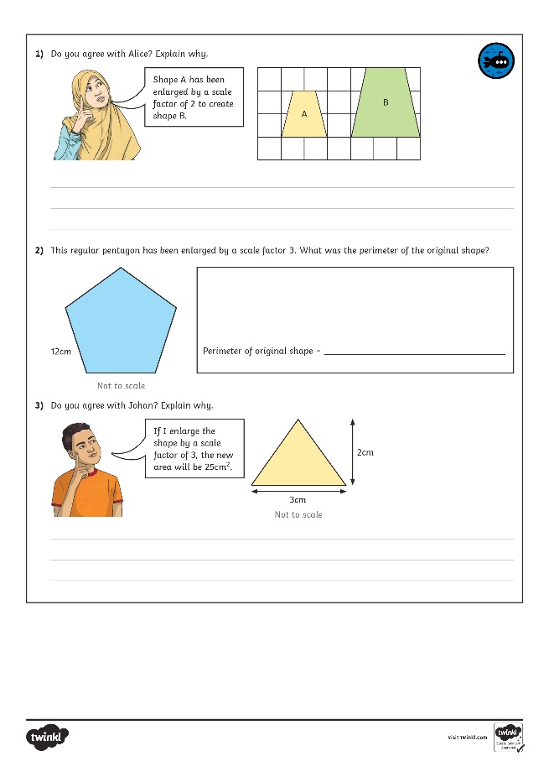
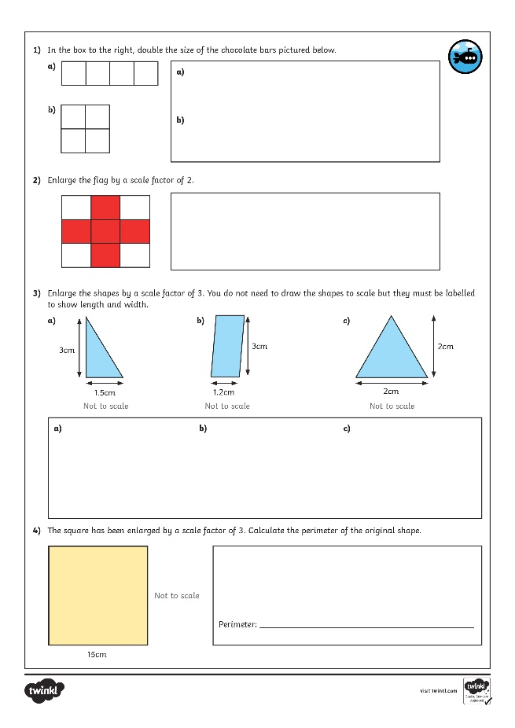
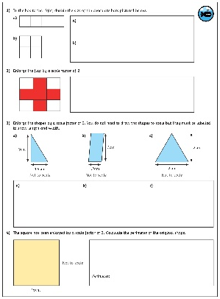
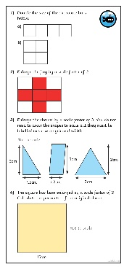
Using Scale Factors
Look at the activities attached and complete as much as you can.

