Slide 1
Wednesday 13th May
WALT: calculate scale factor problems

Slide 2

Calculating Scale Factors
Diving
Shape A has been enlarged to create shape B. What scale factor has been used to create shape B?
scale factor 1
scale factor 1
B
A
scale factor 2
scale factor 2
B
scale factor 2.5
scale factor 2.5
A

Slide 3


Insert White Rose Aim Here
Calculating Scale Factors
Deeper
Roman is incorrect. Shape B is similar to shape A as it has been enlarged by a scale factor of 2. As shape C is a rectangle, it
cannot be an accurate enlargement of shape B
or shape A.
C
B
A
When considering scale factors, I think that shape B and C are similar to shape A.
Do you agree with Roman? Use reasoning to explain your answer.

Slide 4
Insert White Rose Aim Here
Calculating Scale Factors
Deeper
A rectangle has a perimeter of 17cm.
An enlargement of this rectangle has
a perimeter of 68cm.
The length of the original rectangle is 5cm.
68cm ÷ 17cm = 4
The orange rectangle has been enlarged by a scale factor of 4.
68cm – 40cm = 28cm
28cm ÷ 2 = 14cm
Calculate the length and width of the enlarged rectangle.
Not to scale.
20cm
original rectangle
enlarged rectangle
14cm
14cm
5cm
5cm × 4 = 20cm
20cm

Slide 5

Calculating Scale Factors
Deepest
Rectangle A has been enlarged to create rectangle B.
Use the following clues to identify which scale factor has been used:
The perimeter of rectangle A is 12cm.
The length of rectangle A is 4cm.
Shape B has an area of 72cm².
4cm
rectangle A
2cm
Not to scale.
Area of rectangle A: 4cm x 2cm = 8cm²
72cm² ÷ 8cm² = 9
rectangle B
If the area has increased by 9 times, then the scale factor applied to each side length of the rectangle must be 3.
(l × w) = area
6cm
12cm
A scale factor enlargement of 3 has been applied.

Slide 6
Calculating Scale Factors
Deepest
Enlarge this shape in three different ways, each time using a scale factor less than one whole.
Examples of possible answers:
The side lengths are 4.5cm when a scale factor of 0.9 is applied.
The side lengths are 2.5cm when a
scale factor of 0.5 is applied.
5cm
The side lengths are 1cm when a scale factor of 0.2 is applied.
The side lengths are 0.5cm when a scale factor of 0.1 is applied.
5cm

Slide 7


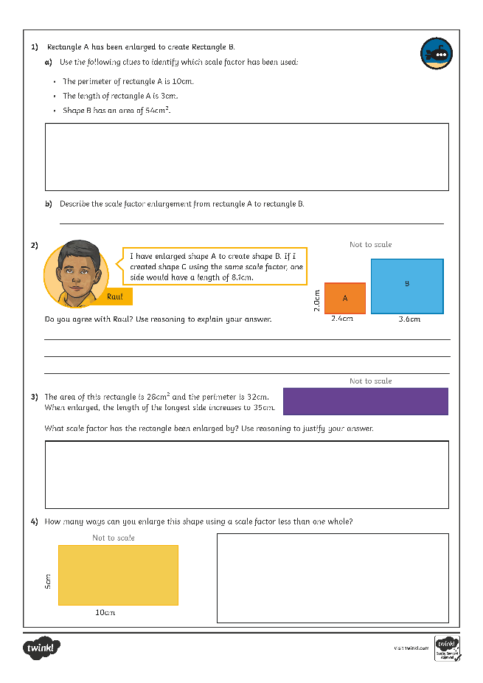
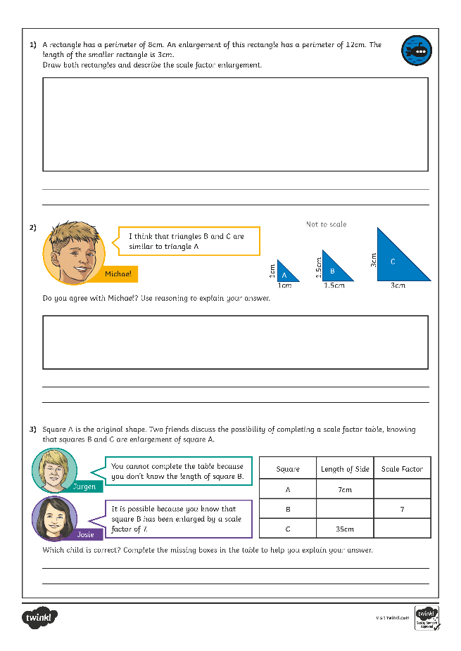
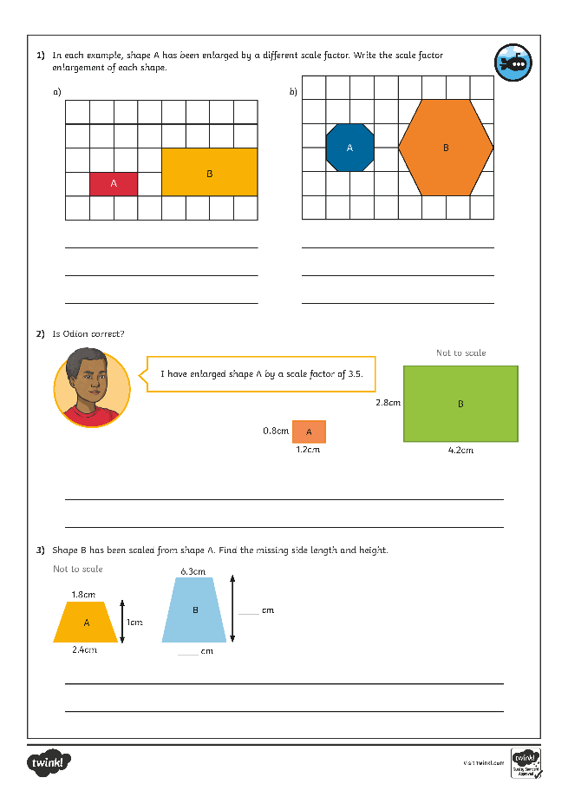
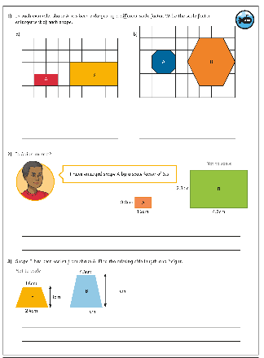
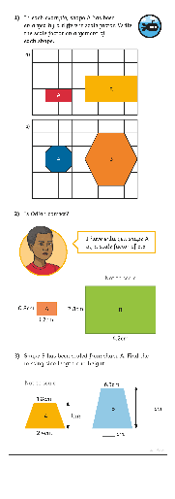
Calculating Scale Factors
Dive in by completing your own activity!

