Slide 2
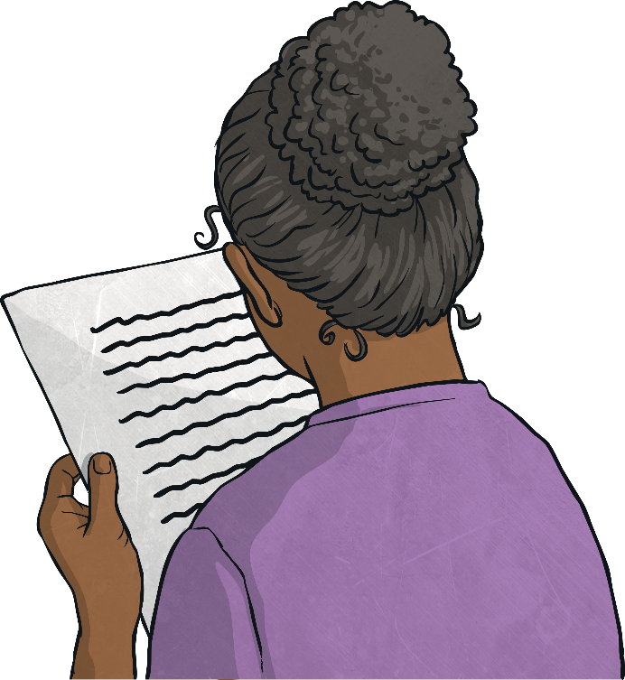
Poetry
Poetry is a form of literature and a very wide genre of writing. It is a form of imaginative writing that can be written by anybody. People choose to write poetry based on many different things. Expressing thoughts and feelings about something in a creative way is what poetry is all about.
The main aim of poetry is to involve and stimulate the thoughts of the reader. Poetry can connect with a reader on an emotional level too.
Poetry has many different forms, and can be written in many different ways. They can be short or long, fun or sad, real or imagined, structured or unstructured, rhyming or not. There is a lot of freedom when writing poetry and because of this, the writer is able to express their thoughts and feelings in very unique ways.

Slide 3
Poetry
There are many different ways you can write poetry. The next few slides give you some examples of things you can include when writing poems.

Slide 4
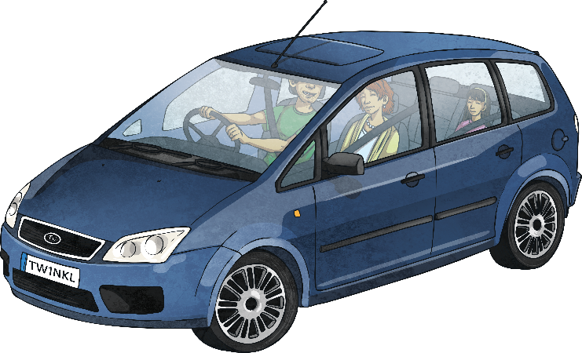
Adjective Poetry
Adjectives are describing words. They are used in poetry to create many different effects and visual pictures to the reader. The adjectives can be used for a more in-depth description of a noun, or they can be used to add more excitement and attention within a line or verse.
Roaring roads,
Noisy cars,
Beaming headlights,
Tall streetlamps,
Dark, cold night.

Slide 5
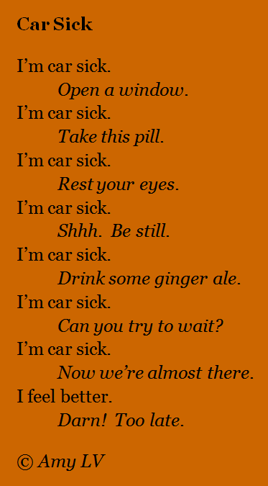
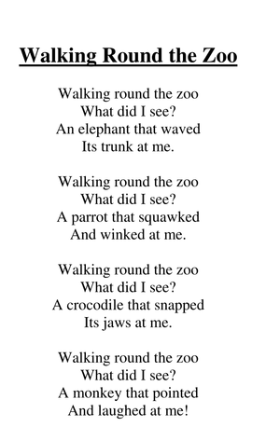
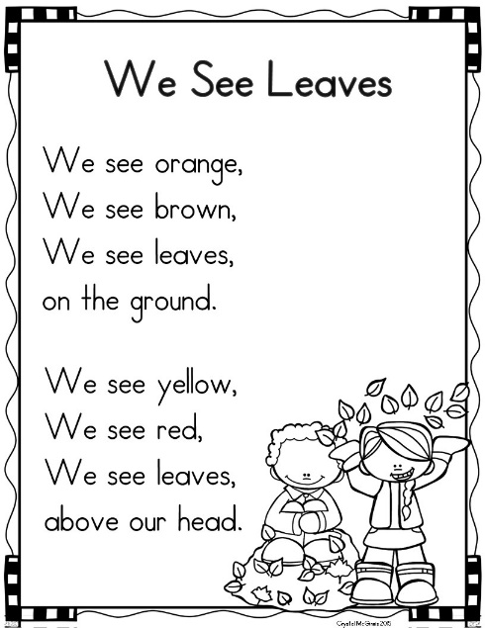
Using Repetition
Repetition is when a certain word, sentence or
phase is written more than once in a poem.
Repetition is used in poetry to help make the poem more
interesting, and to help create patterns. Depending on the word
or phrase that is repeated, repetition allows for more emphasis to be placed on certain themes, ideas or objects.
Some examples of where repetition in poetry:

Slide 6

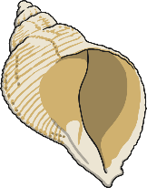
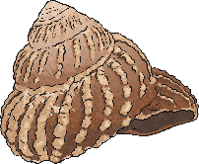

Alliteration
Alliteration is when the sound or letter at the beginning of each or most of the words in a sentence is the same.
Alliteration is used in poetry to create many different effects.
It can be used to create a greater and more interesting description
of different themes, people and objects.
Some examples of alliteration:
Sally sells sea shells by the sea shore.
All authors allow authority after midnight.
Theresa tripped and tumbled tremendously over the tree.

Slide 7
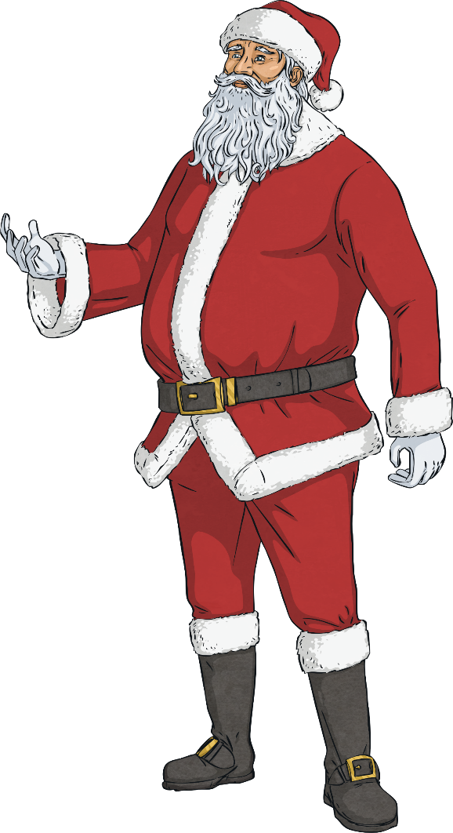
Chorus
A chorus is the part of a song or poem that is repeated after verses.
A chorus is used in poetry to create more drama around and emphasis
of a particular idea or theme.
Some examples of choruses:
We wish you a Merry Christmas,
We wish you a Merry Christmas,
We wish you a Merry Christmas,
And a happy New Year!
Glad tidings we bring,
To you and your kin;
Glad tidings for Christmas
And a happy New Year!
We wish you a Merry Christmas,
We wish you a Merry Christmas,
We wish you a Merry Christmas,
And a happy New Year!

Slide 8
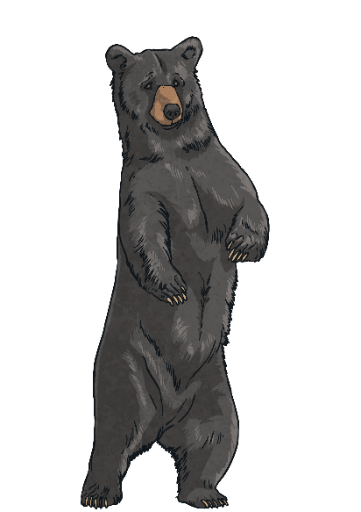

Rhyme
Rhyme occurs when two words sound the same when spoken out loud. These words usually have the same ending sounds,
however they don’t need to be spelt the same.
Rhyme is used in poetry to create something interesting to read.
It is used to create a pattern within a poem.
Some examples of rhyme:
Fright and night
Would hood
Should could
Hail and pale
Male and stale
Air and fare
Two and do
Day and sway
Pause and claws
Bears and stairs

Slide 9

Simile
A simile is a figure of speech. It is when one thing
is compared to another using the words ‘like’ or ‘as’.
Similes can be as descriptive as the writer chooses.
Similes are used in poetry to give the reader a more descriptive and
in-depth understanding about a particular object or person.
Some examples of simile:
As busy as a bee – This is comparing someone’s level of energy to the speed of a bee.
As snug as a bug in a rug – This is comparing someone who is very cosy to how comfortable a bug would be in a rug.
Runs like a cheetah – This is comparing the speed that someone can run to the speed of a cheetah which is quite fast.
As white as a ghost – This is comparing a person’s skin colour to a ghost, usually because they are frightened, sick or scared of something.

Slide 10

Synonym
A synonym is a word that has the same, or similar, meaning
as another word. Synonyms can be found in a thesaurus.
Synonyms are used in poetry to be more graphic
and to give a broader description.
Some examples of synonyms:
Beautiful – attractive, pretty, gorgeous, stunning
Funny – hysterical, humorous, amusing, entertaining
Student – pupil, scholar, schoolboy, schoolgirl
Lazy – idle, sluggish, indolent, slothful

Slide 11
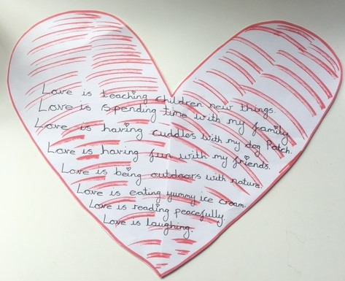
Using Repetition
This week we are going to focus on poems with repetition.
I have written a poem. Can you tell your grown up what is being repeated in my poem and what is not the same? What did you like about the poem?

