Slide 1
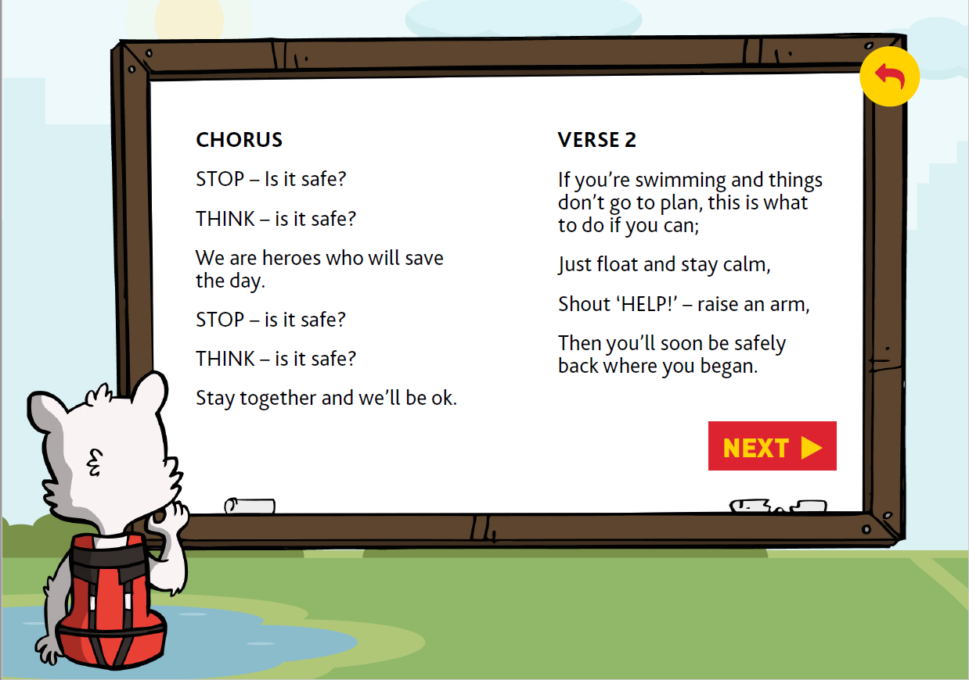
WATER HERO SONG

Slide 2
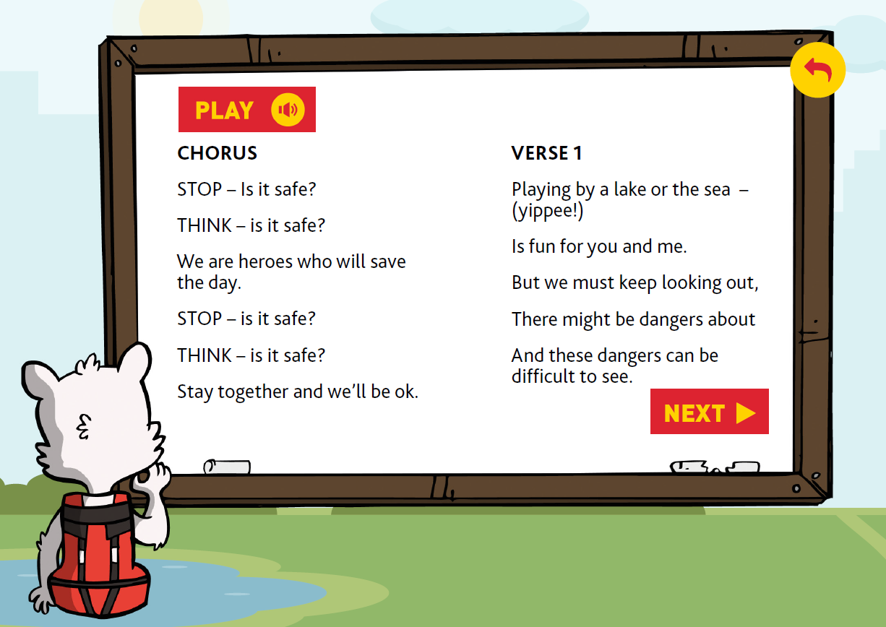

If the link for the music doesn’t work, the Water Hero song is on the school’s website under home learning for this week.

Slide 4


