Slide 1
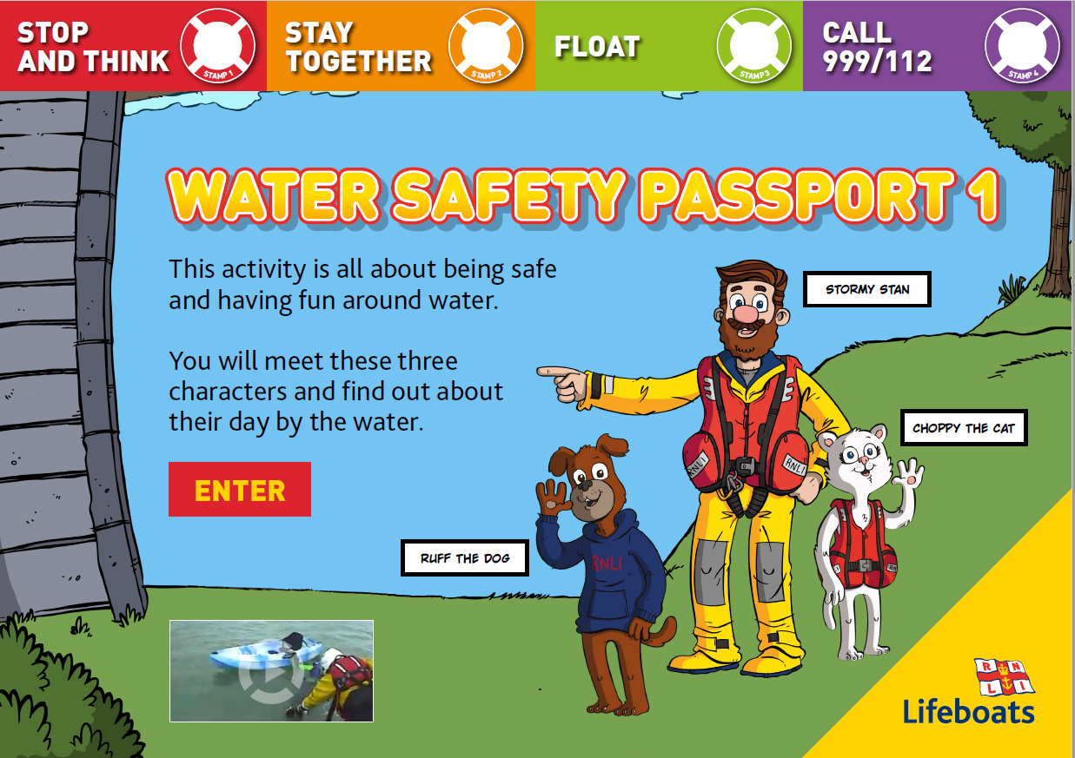
To watch the video, click on the triangle and scroll down on the website to find it.

Slide 2
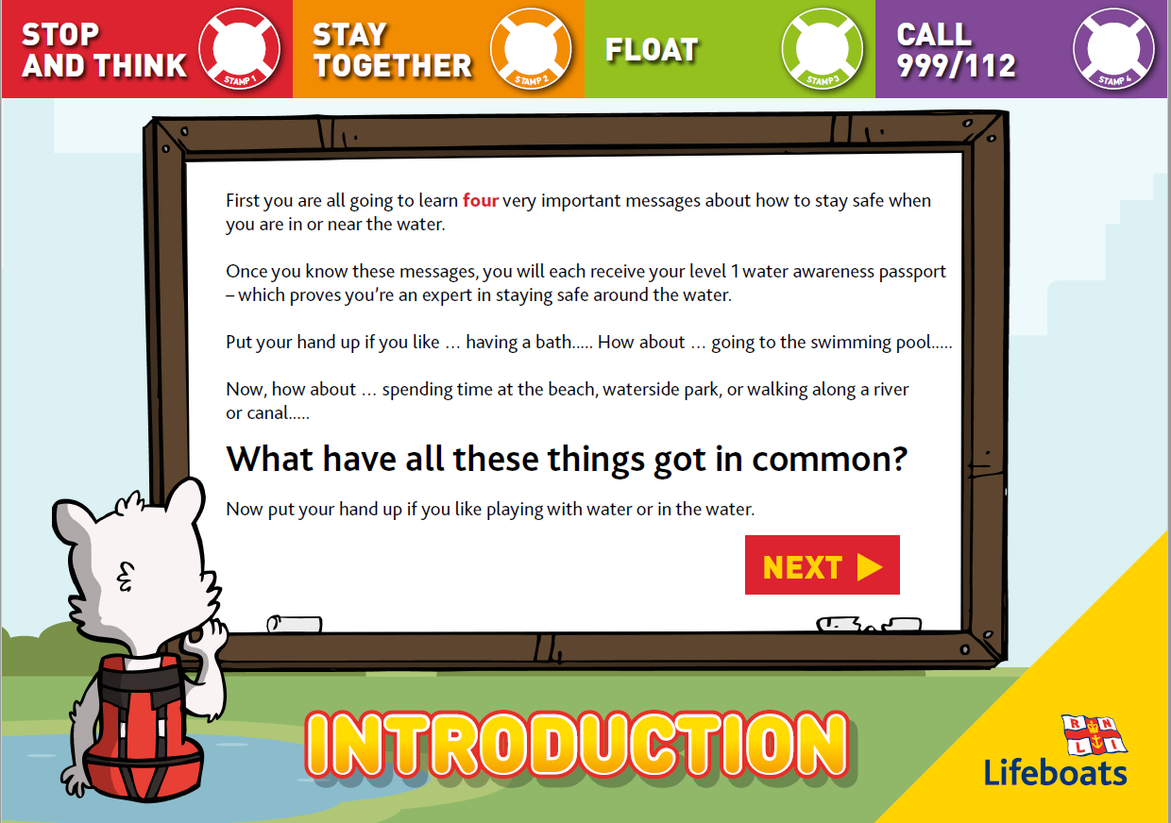

Slide 3
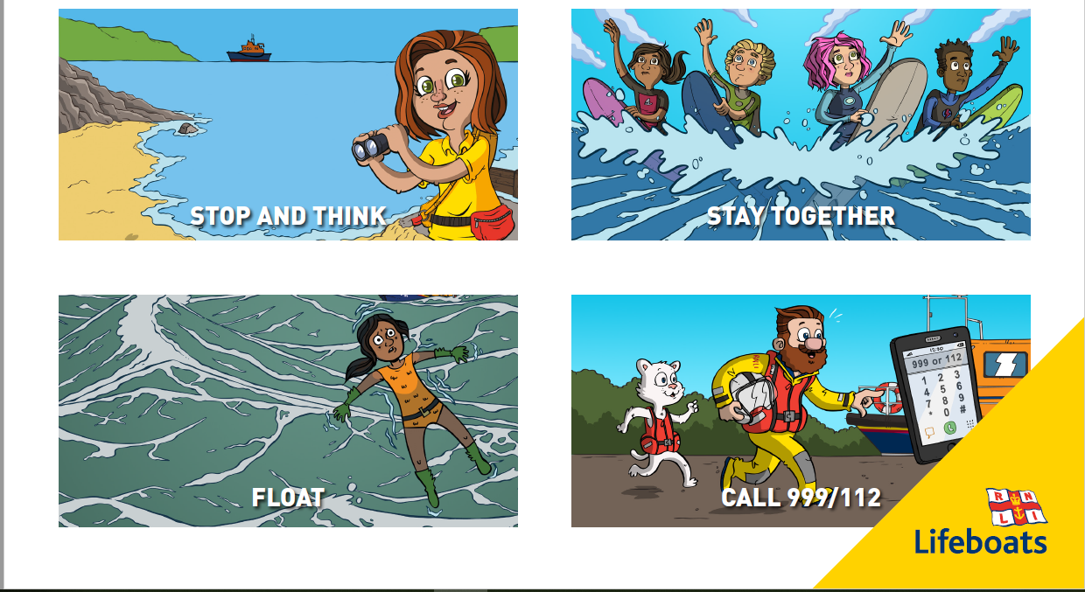

Slide 4
1. STOP AND THINK
This rule is about being detectives and thinking about and looking for any possible dangers that can be found in or around the water.
Can you name any?
Here are some suggestions: glass on the beach, tide coming in, currents, jellyfish, sharp rocks, getting lost.
By spotting and thinking about dangers before you make a choice to do something, you can help keep yourself and others safe.
Let’s have a look at the picture on the next slide to see if you can spot any dangers.

Slide 5
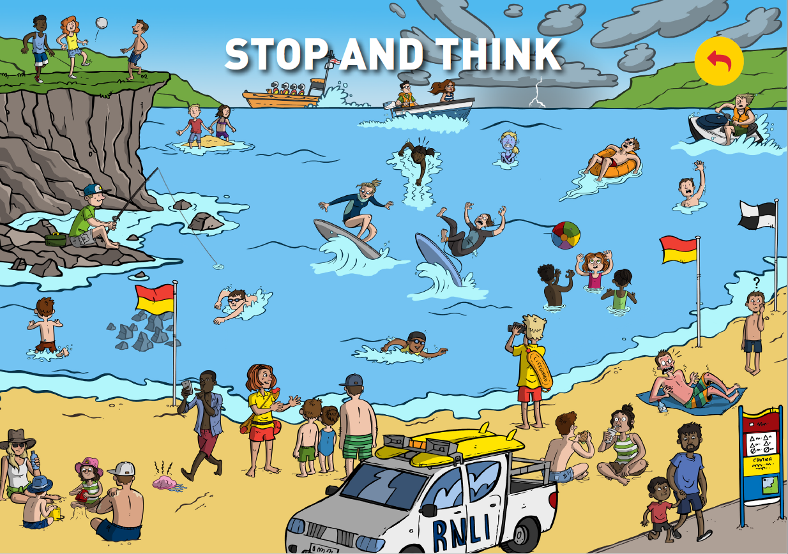
Once you have had a try, go to the next slide for some answers.

Slide 6
Too close to the cliff edge
Cut off by the tide
She isn’t wearing lifejacket.
Storm coming
Caught in a rip tide
Heading towards the swim zone
Very cold
Blown out to sea
In trouble
Fishing on rocks – not wearing a lifejacket
Falling off surf board
In swim zone, not surf zone
Outside the swim zone
Rocks
Sunburnt
Lost boy
Jellyfish

Slide 7
2. STAY TOGETHER
The second of our important water safety rules is to stay together.
What do you think this means?
It means to always stay with the grown up who has taken you to the
water. So, Mum, Dad, Gran, Grandad, a teacher, Aunty or Uncle, carer or guardian. Staying with an adult and holding their hand when you are asked to is important as it means they can make sure you don’t get lost on a busy beach.
It also means that if you’re swimming in the water and you get into difficulty, that a grown up is there to help you.

Slide 8
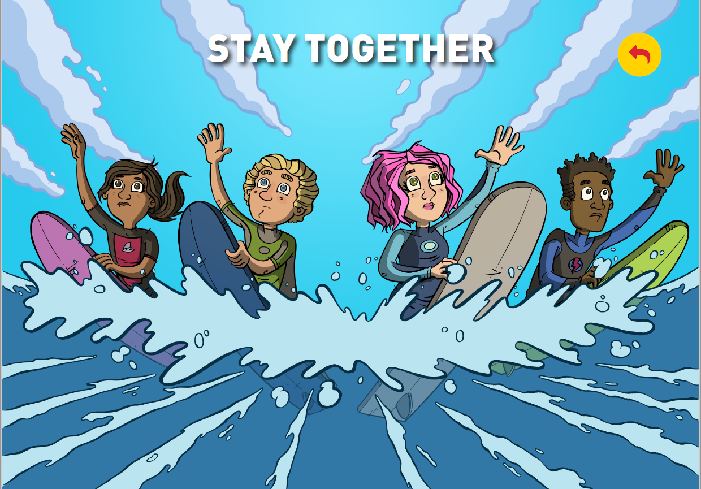

Slide 9
3. FLOAT
This rule is very important if you ever fall into cold water. If that happens, your body will be shocked by the cold temperature and this can make you gasp and swallow water. So instead you need to relax and float until you feel calm.
A great place to practise your floating skills is during swimming lessons.
People can float in lots of different positions. Some children may have learnt to float like a star in swimming lessons. This is a really important skill to practice.
Why not practice the float position standing up in your learning space.

Slide 10
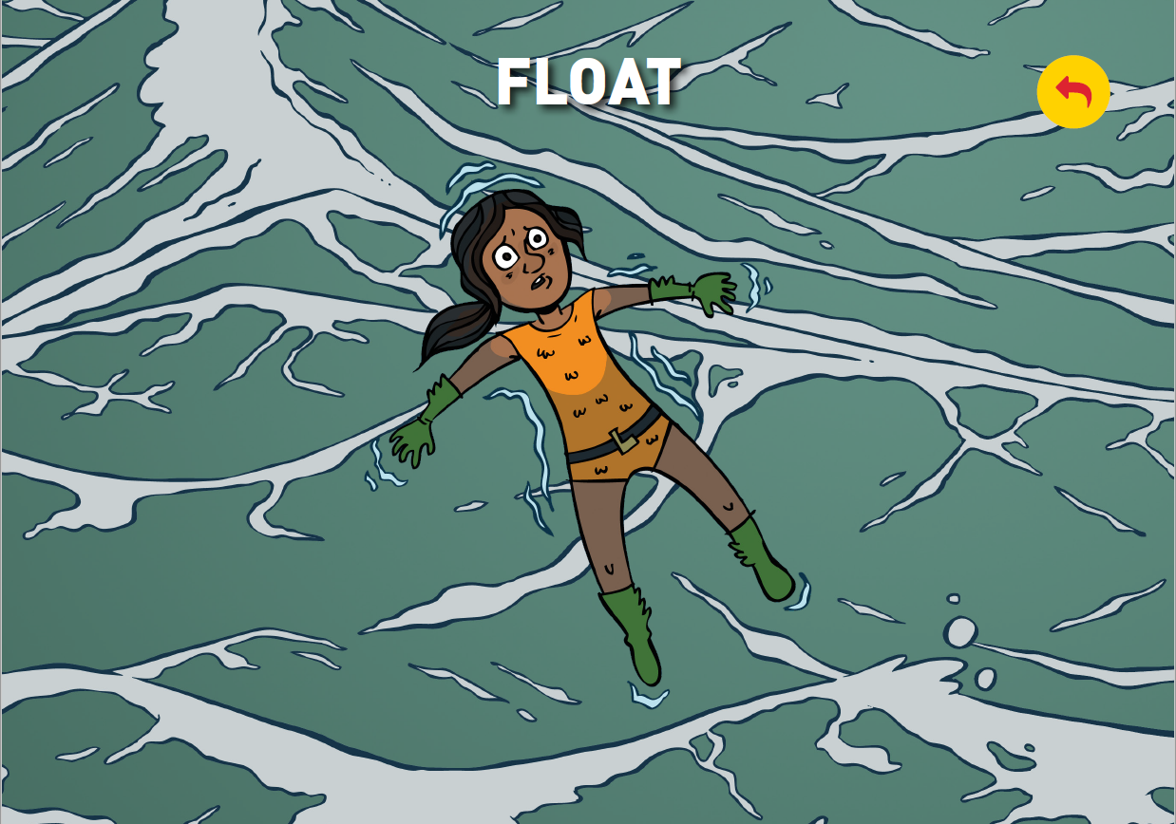

Slide 11
4. CALL 999/112 OR SHOUT FOR HELP
I’m sure you all know that police officers, fire fighters and ambulance crew are here to help us in an emergency. They will even help us if we get into trouble around water.
Now what do we call the people who look after you and GUARD your LIFE at the beach or pool?
That’s right! Lifeguards.
Does anyone know the special number we call to contact any of the emergency services (like the Police, Fire Brigade and ambulance)?
Yes, 999 and this special number can also be called if you see someone in difficulty in the water. You would ask for the Coastguard. Well done everyone!
Did you know 112 is the emergency number used in
Ireland and the rest
of Europe.

Slide 12
4. CALL 999/112 OR SHOUT FOR HELP
Now if you don’t have a phone and you see someone in trouble in the water who needs help what could you use? All of us have one, it makes lots of different sounds from a quiet whisper to a loud SHOUT, and
I’m using mine right now.
That’s right, YOUR VOICE. You can SHOUT!
Let’s practice calling for help shall we?

Slide 13
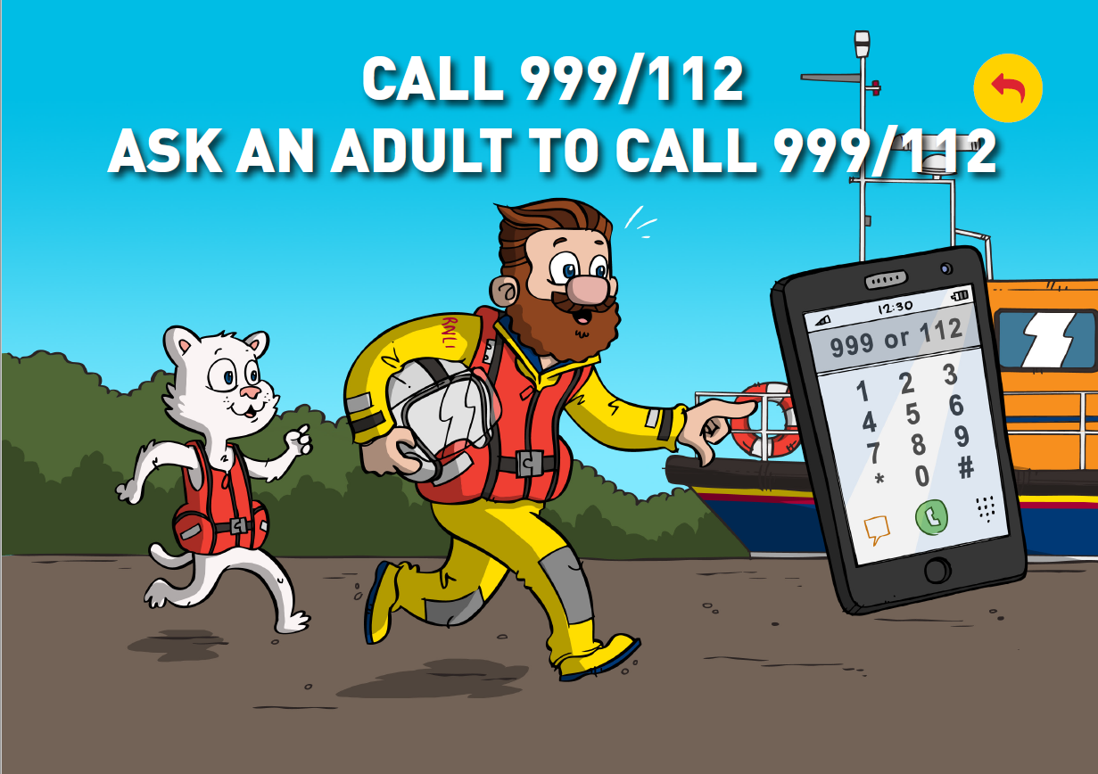

Slide 14
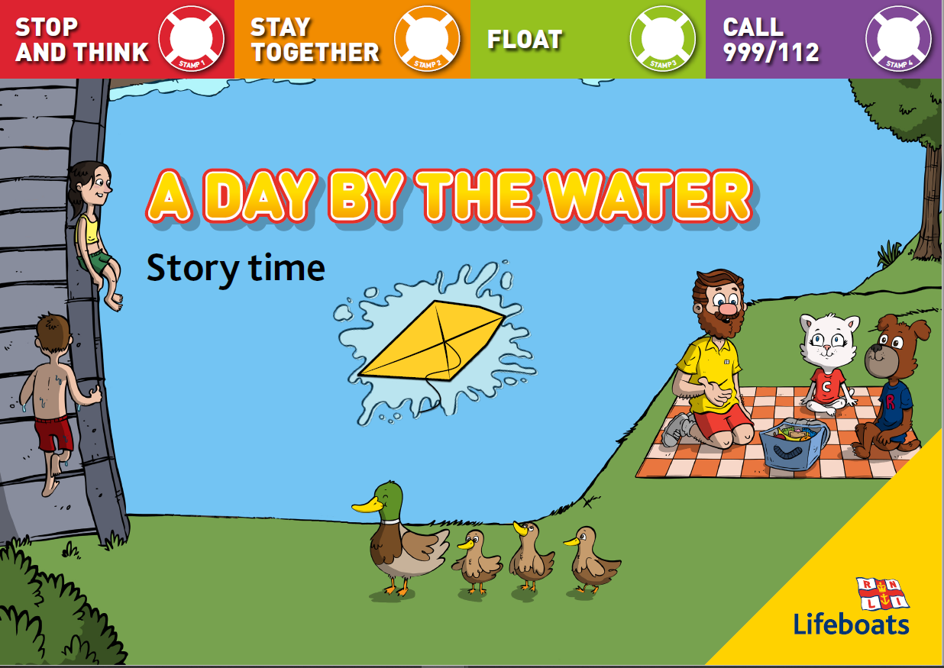
Choppy the cat and Ruff the dog are best friends. They do everything together. They go to the same school, share the
same friends, and even have the same favourite snack.
When Stormy Stan took them for swimming lessons, Choppy and Ruff both learned to swim at the same time. They
were very proud of how well they could swim AND they had just learnt how to float without their arm bands.

Slide 15
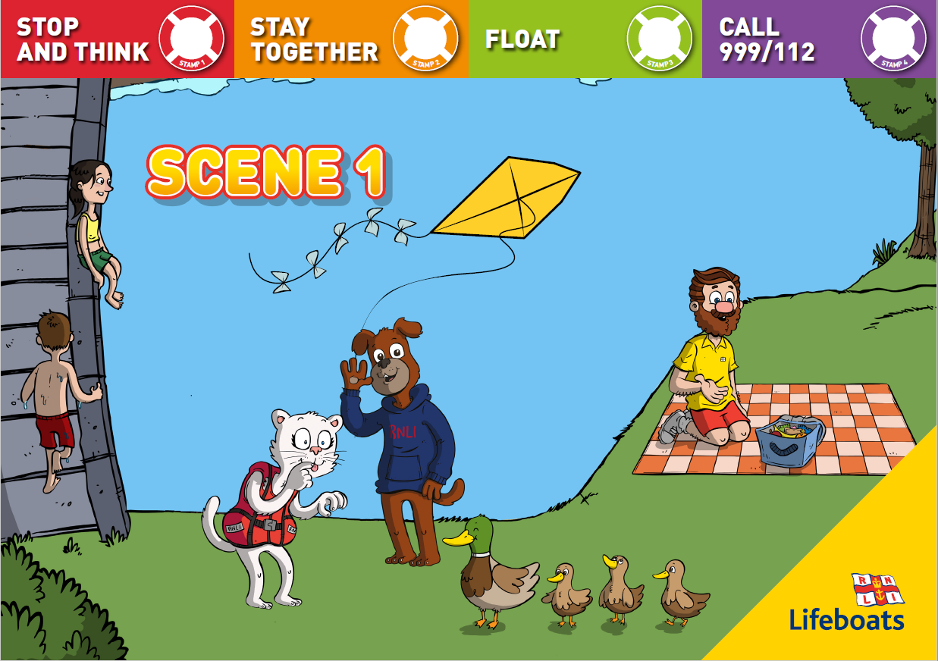
One sunny day Stan took them to the park for a picnic.
Choppy and Ruff were running and jumping around while Stan set out the picnic blanket. He had packed their favourite cheese sandwiches and was sorting out their lunch.
Choppy and Ruff were having a brilliant time, climbing the big oak tree and playing with Ruff’s new kite.
‘Don’t go too far!’ called Stan.
‘We won’t’ replied the friends at the same time (they often said the same thing at the same time). Just then Choppy spotted a duck with three fluffy yellow ducklings.
‘Look Ruff!’ she shouted, jumping up and down excitedly. But the ducks were too quick and disappeared
into the trees before Ruff could see them.
‘What is it?’ Asked Ruff.
‘Ducks! Let’s follow them’ said Choppy, still jumping up and down. She loved chasing birds. Ruff wasn’t sure. ‘But Stan told us to stay near him where he can see us’ he said with a worried look on his face.

Slide 16
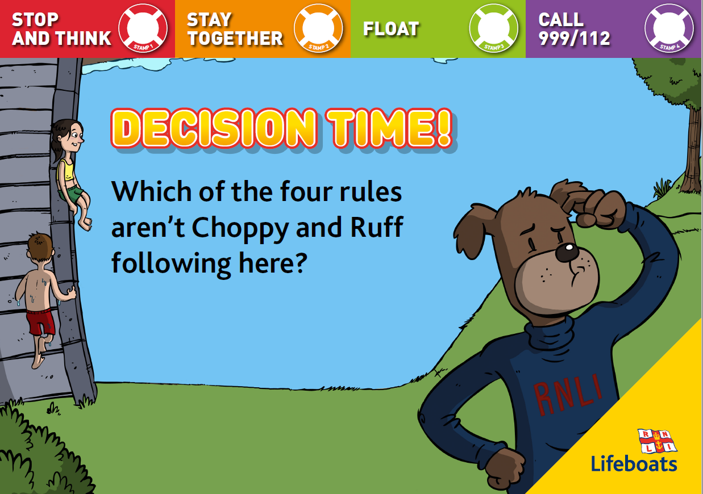

Slide 17
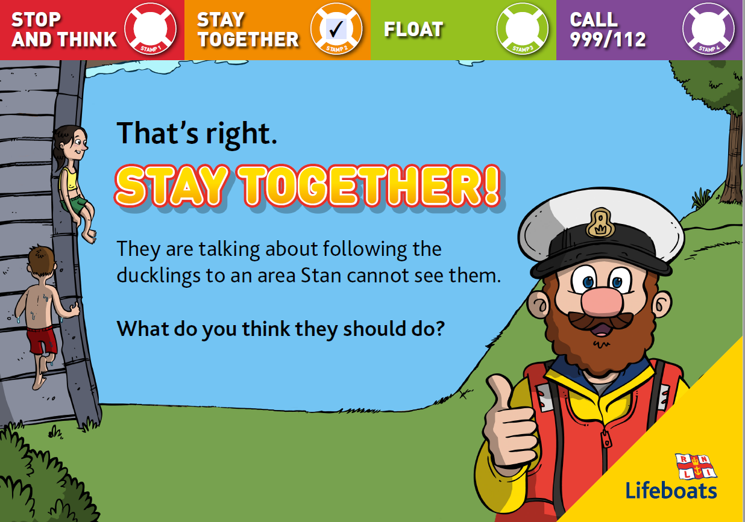

Slide 18
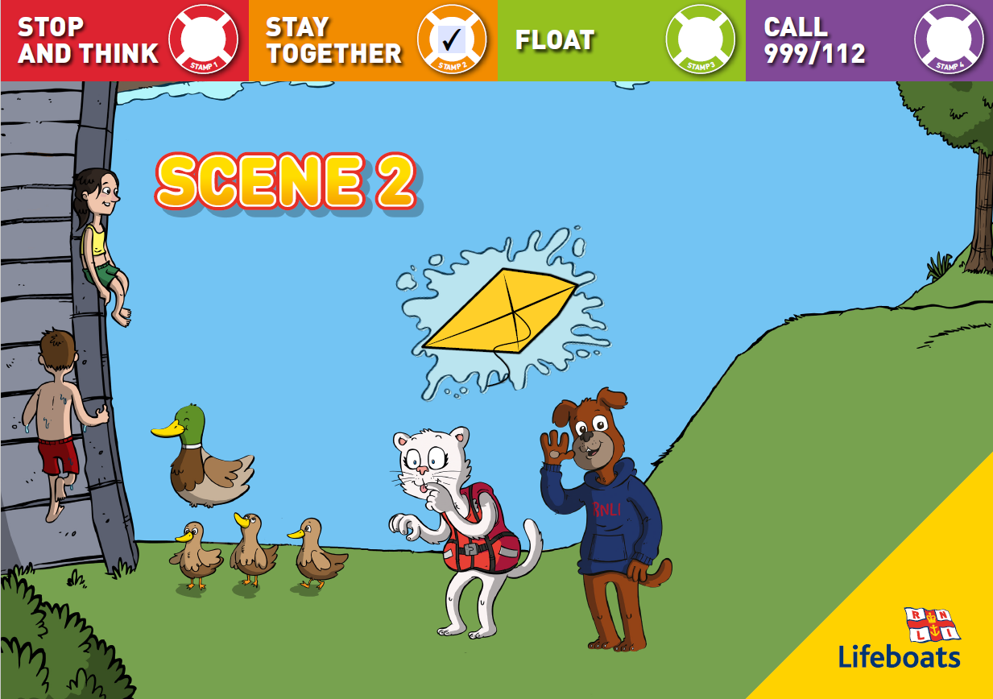
Ruff looked back at Stan who was still unpacking the boxes from their picnic basket.
‘I don’t think the ducks have gone far’ said Choppy. ‘They’ve probably headed to the lake just over there’ she urged, pointing down towards the bridge. ‘Come on!’ The friends ran down the steep hill towards the lake. They could see the ducklings hopping into the calm water one after the other.
‘Let’s go onto the bridge so we can get a better look’ suggested Choppy, now feeling excited she would get to see the ducklings up close. As the friends stood on the low bridge, a gust of wind swept Ruff’s kite straight out of his hand and into the lake.
‘Oh no!’ howled Ruff as the kite, skimmed across the water and landed in the middle of the lake. ‘That’s my new kite!’
‘Don’t worry’ said Choppy. ‘Let’s wait for the breeze to blow it closer to the bank. From there I should be able to reach it without getting wet’.

Slide 20
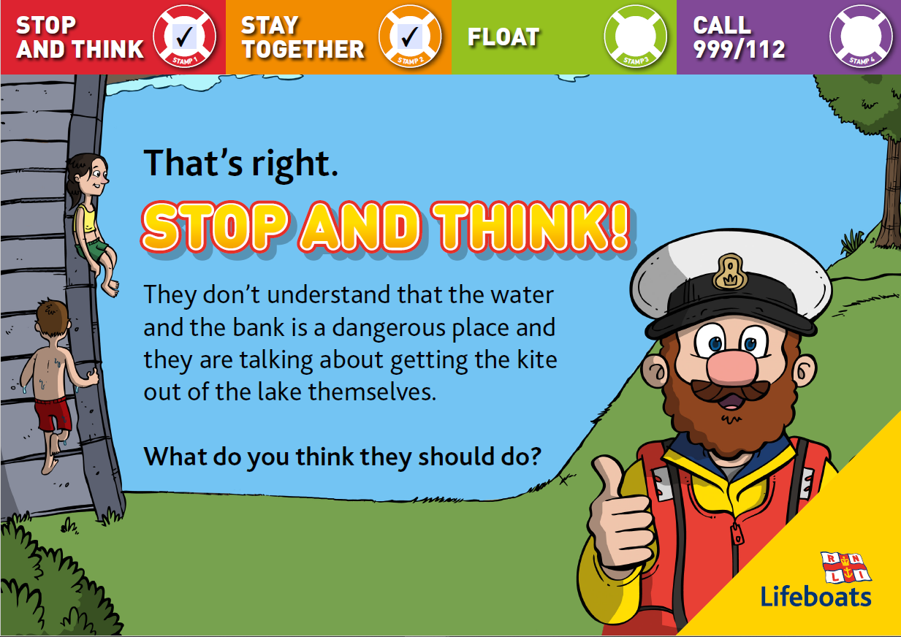

Slide 21
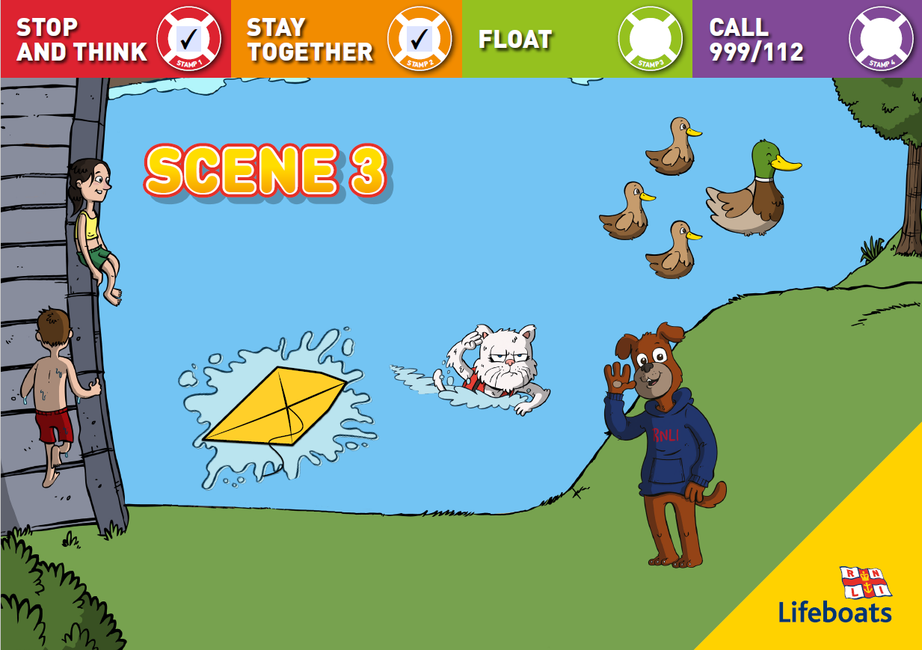
Choppy didn’t appreciate that the bank was slippery and the ground wasn’t safe and now she has fallen. She should have remembered the STOP AND THINK advice.
The friends waited for a few minutes and sure enough the gentle breeze blew the kite towards the muddy bank. Choppy grabbed a stick and climbed down the steep bank to try to collect the kite but as she leaned out to grab it, the ground under her feet fell away and she tumbled into the lake. The water felt like ice. Although it was a warm, sunny day Choppy had never felt so cold or shocked. She gasped for air, trying to keep her head out of the water so she didn’t swallow any of it.

Slide 22
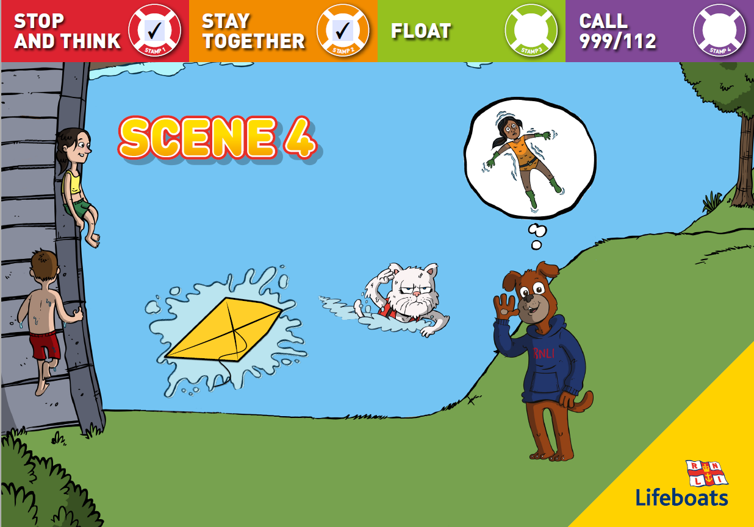
‘Wait!’ Cried Ruff. ‘Remember what we were told to do if we ever fell into cold water Choppy. Float!’ She had been practising how to float in her swimming lessons.

Slide 23
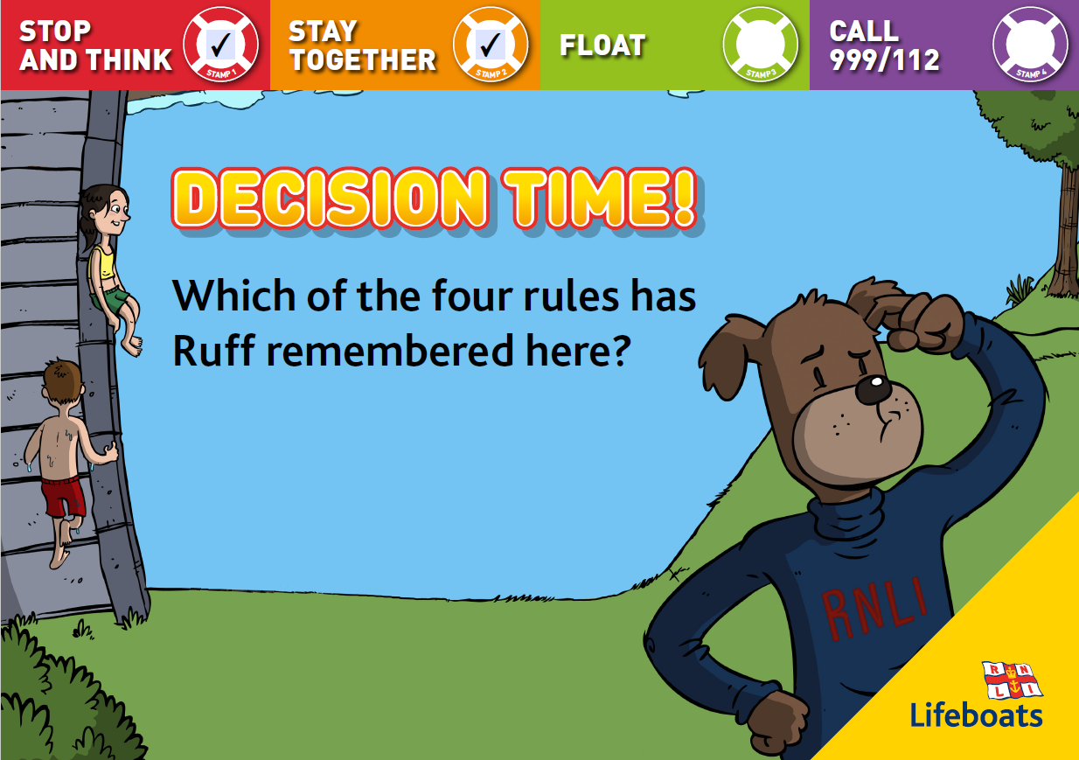

Slide 24
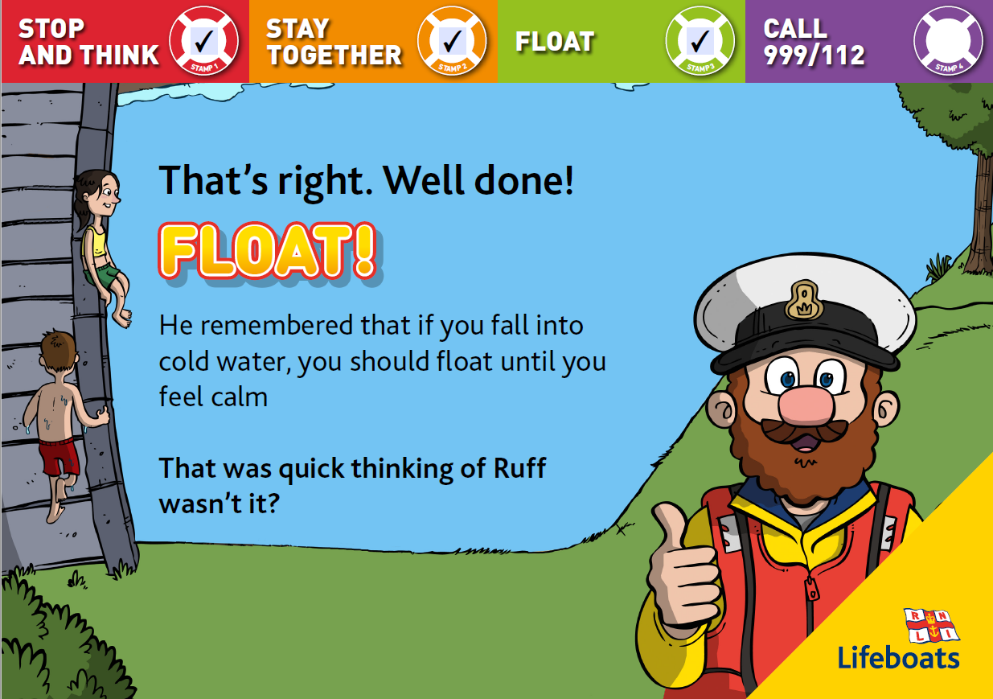

Slide 25
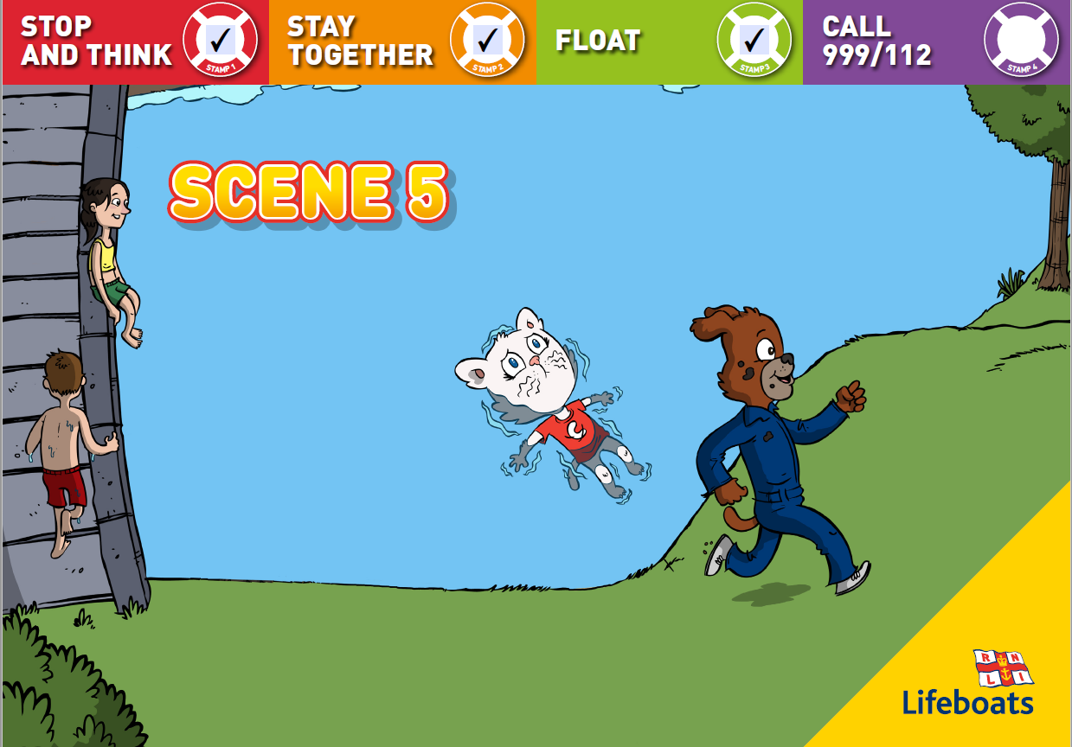
Choppy remembered. She had been practising how to float in her swimming lessons. She leant back in the cold water and pushed her tummy up towards the sky, stretched out her arms and legs and began to float while she controlled her breathing.
‘I’ll get Stan to help’ shouted Ruff and ran back up the
hill as fast as he could. Shouting for Stan to come
quickly. After a minute, Choppy could feel her breathing
begin to steady and she felt ready to swim back towards the
bank. When she got there, Stan was there to help her out. He looked very worried.
‘Choppy! Choppy! Are you ok?’ Stan cried, pulling a soggy, cold, sorry looking Choppy from the lake.
‘I’m so sorry Stan,’ sobbed Choppy ‘We should never have run off where you couldn’t see us.’
Stan smiled and wrapped Choppy in his big coat and the three of them headed back towards the picnic spot, very glad that they knew what to do in this kind of emergency.
‘I’m never going to run off again’ said Choppy.
‘Neither am I’ said Ruff, happy his friend was safe.
And they both happily tucked into their lunch.

Slide 26
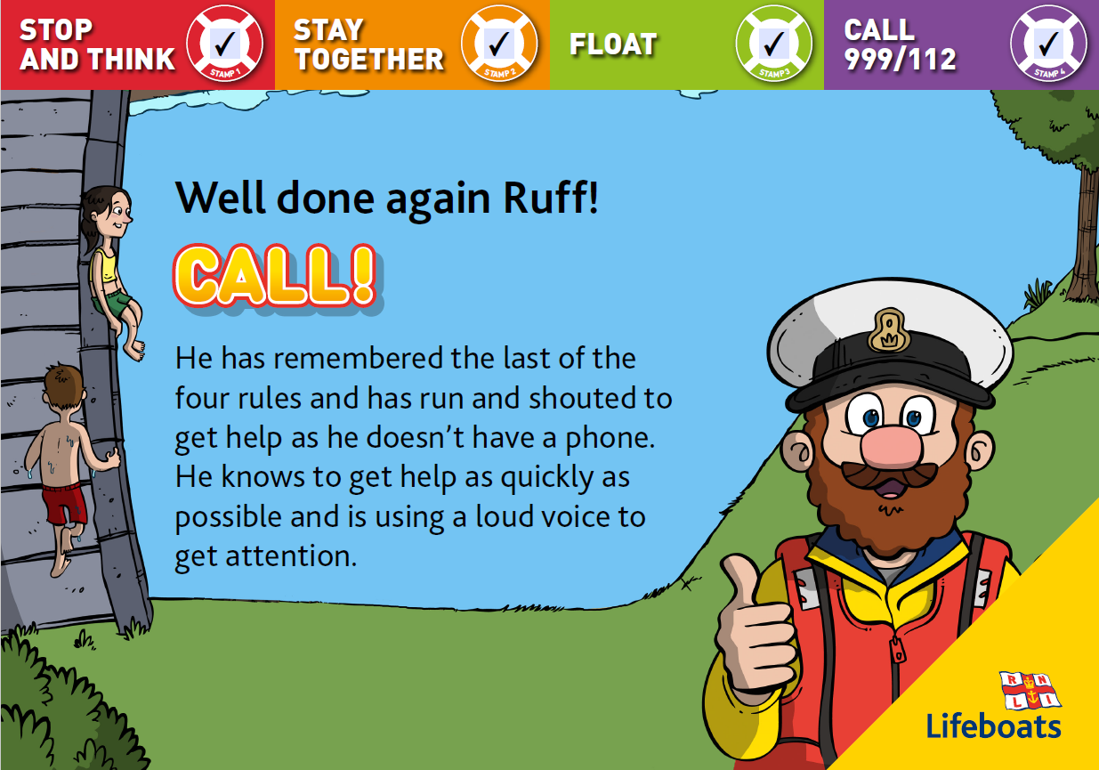

Slide 27
Choppy and Ruff were very lucky they knew what to do in this type of emergency but let’s have a look at the decisions they made that day to see if more sensible choices could have been made.
1. STOP AND THINK
The friends did not follow RNLI advice and look out for dangers at the lake. The bank was slippery and wet and the ground was unsafe. What do you think Choppy and Ruff should have done when Ruff’s kite blew into the water?
2. STAY TOGETHER
They did not stay where Stan could see them. Sticking together is very important when you are near water. Never venture too far away from a grown up. Always hold a grown ups hand when asked to.
3. FLOAT
Fortunately Choppy knew how to do this. She knew that if you accidentally fall into cold water it is important to float
until you feel calm while your body gets used to the temperature and your breathing goes back to normal.
When your body experiences the shock of falling into cold water, the normal reaction is to gasp which often means you swallow water.
4. CALL 999/112
Ruff knew it was important to get help immediately and he was lucky Stan was there. If you see someone in trouble in the water and there is nobody there to help, you should call 999/112 or find a grown up to do it for you. If you don’t have a phone, use your voice to shout as loud as possible until someone hears you.

Slide 28
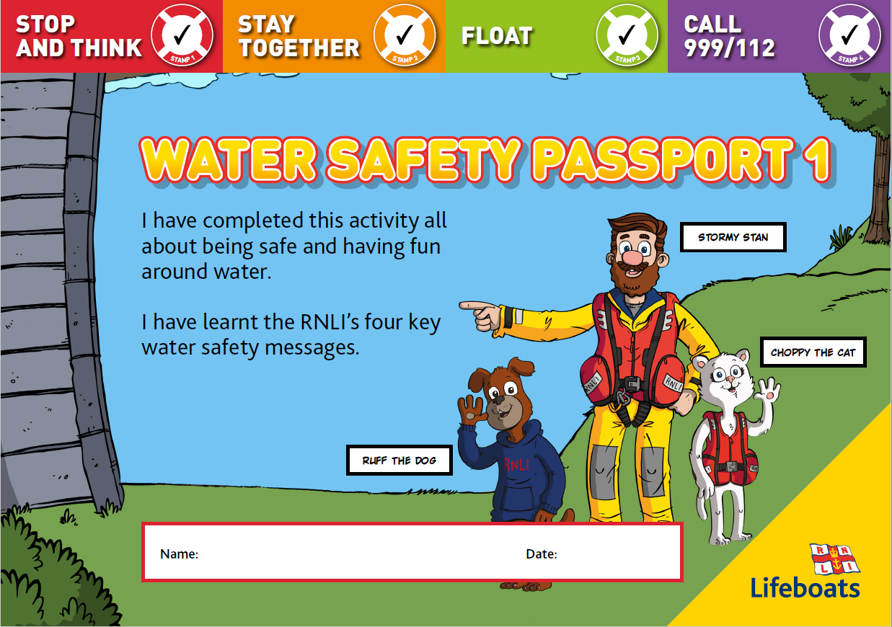
Fantastic work! You have earnt your Water Safety Certificate.
The certificate, which is attached to the school’s website under the home learning tab for this week can be saved or printed.

