Slide 1


Science
Properties and Changes of Materials
Year One
Science | Year 5 | Properties and Changes of Materials | Brighter Bulbs | Lesson 3

Slide 2
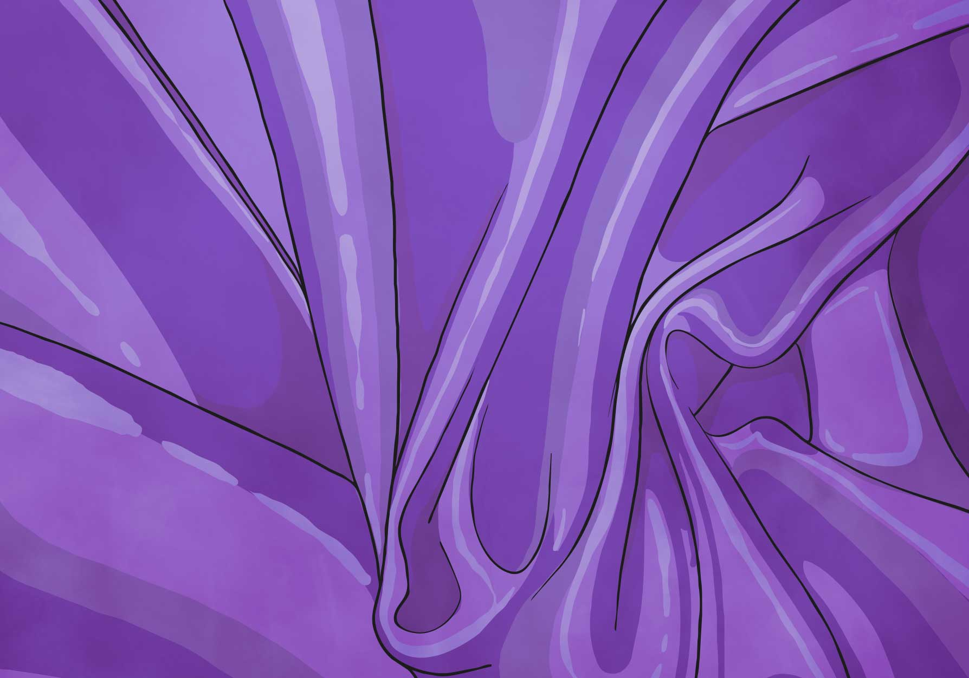

Brighter Bulbs

Slide 3
Aim
I can investigate which electrical conductors make a bulb shine brightest.
Success Criteria
I can identify electrical conductors and insulators.
I can explain that some materials are better conductors than others.
I can plan and carry out an investigation to find the best electrical conductor.

Slide 4

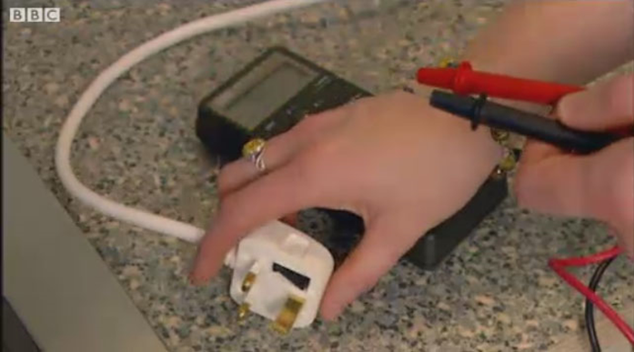

Electrical Conductors and Insulators
Electricity can travel easily through electrical conductors,
but some materials do not let electricity pass through them.
These are known as electrical insulators.
Watch this clip to see some materials that are
electrical conductors or insulators.

Slide 5
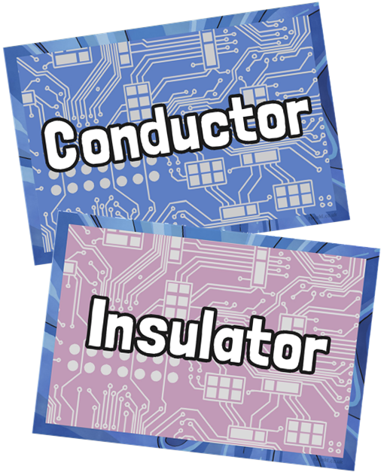
Electrical Conductors and Insulators
We know that metals are electrical conductors, but which other materials conduct electricity?
You are going to play a game to identify electrical conductors and insulators.
Look at each material and decide if it is an electrical conductor or insulator.
Hold up your conductor card or your insulator card to show your choice.
Your teacher will reveal the answer.

Slide 6
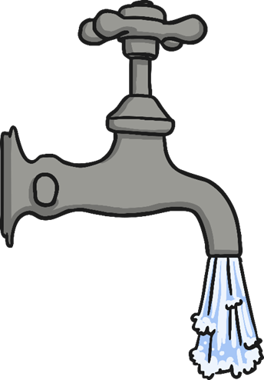
Electrical Conductors and Insulators
Tap water
Electrical Conductor

Slide 7
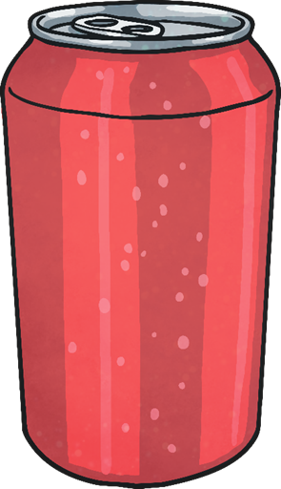
Electrical Conductors and Insulators
Drinks Can
Electrical Conductor

Slide 8

Electrical Conductors and Insulators
Paper
Electrical Insulator

Slide 9
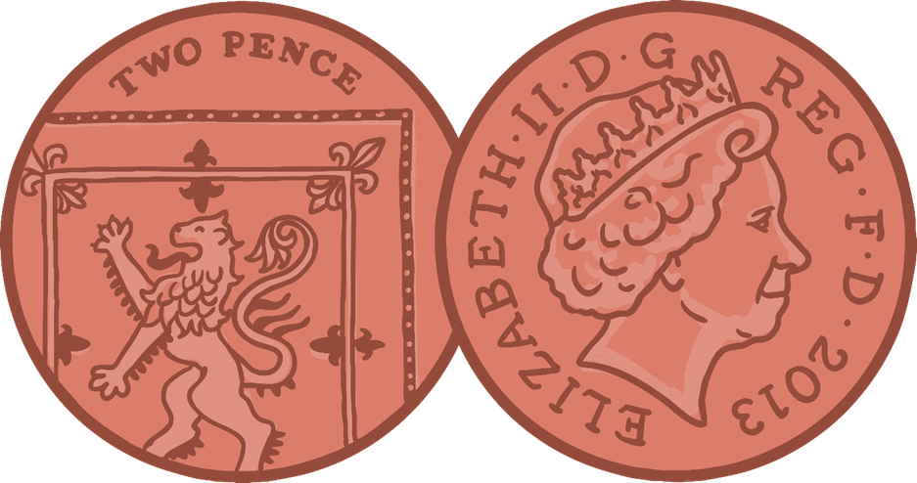
Electrical Conductors and Insulators
2p Coin
Electrical Conductor

Slide 10

Electrical Conductors and Insulators
Rubber Gloves
Electrical Insulator

Slide 11
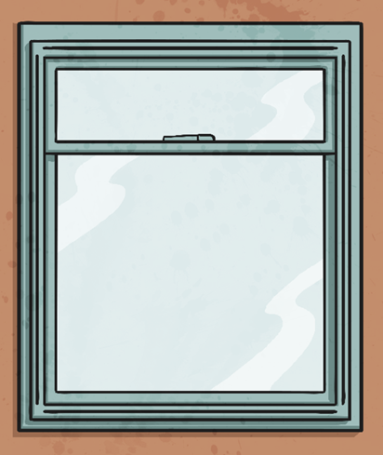
Electrical Conductors and Insulators
Glass Window
Electrical Insulator

Slide 12
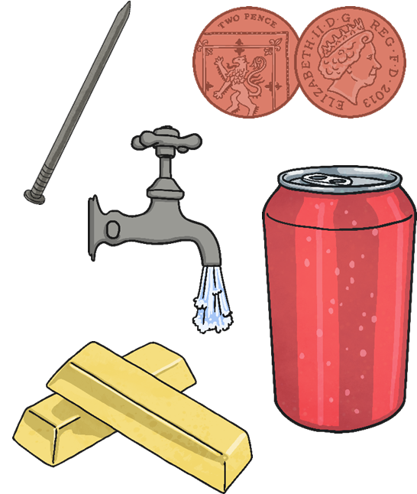
Conductors and Resistance
These items are all electrical conductors.
Some conductors make it easier for electricity to pass through them than others.
All materials have some electrical resistance.
Resistance is the opposition to the flow of electricity through a material.
Electrical insulators have a very high resistance and it is very hard for electricity to travel through these objects.
Electrical conductors have very low resistance and it is very easy for electricity to pass through them.
Different conductors have different levels of resistance, so even through they can all conduct electricity, some allow electricity to flow through easier than others.

Slide 13
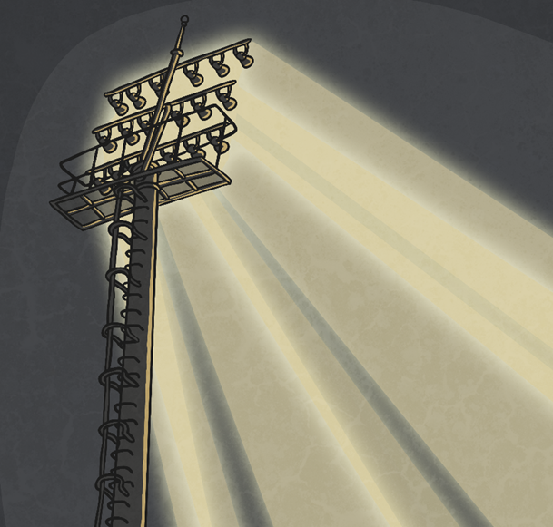
Football Floodlights
A football team need new floodlights to illuminate their football pitch for evening games.
They need to find the best conductors for the circuits in their lights, so that the bulbs in the lights shine as brightly as possible.
They want you to investigate the best electrical conductors, and present your recommendation for which material they should use.

Slide 14


Brighter Bulbs
You will test different materials in a circuit to see which ones conduct electricity best.
You will be able to tell which conductors are the best as they will make the bulb light up the brightest.
You could observe the bulb each time to see how bright it is, or you could measure the light levels using a light sensor.

Slide 15
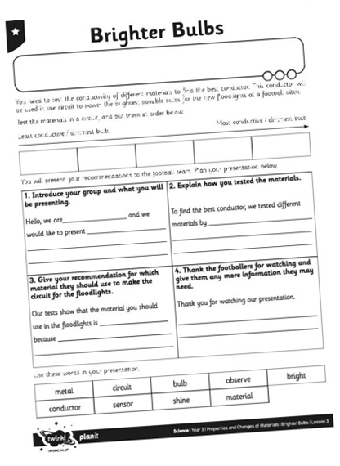

Brighter Bulbs
Use your Brighter Bulbs Activity Sheet to order the materials you test from the worst conductor to the best conductor.
Plan your presentation to the football team on your Activity Sheet.
You may film your presentation to the footballers, or you may present it to your class.

Slide 16
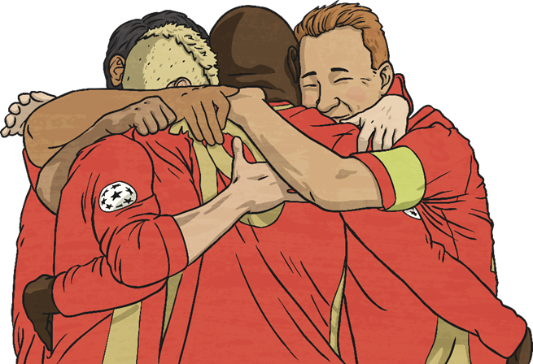

Football Feedback
Thankyou for testing the different materials.
Did all your group recommend the same materials for our floodlights?
We will try out your suggestions.
Were there any differences in your results? Can you give a reason why or why not?

Slide 17

Aim
I can investigate which electrical conductors make a bulb shine brightest.
Success Criteria
I can identify electrical conductors and insulators.
I can explain that some materials are better conductors than others.
I can plan and carry out an investigation to find the best electrical conductor.

