Slide 1

Class 2’s
End of Year Book
2019 - 2020

Slide 2

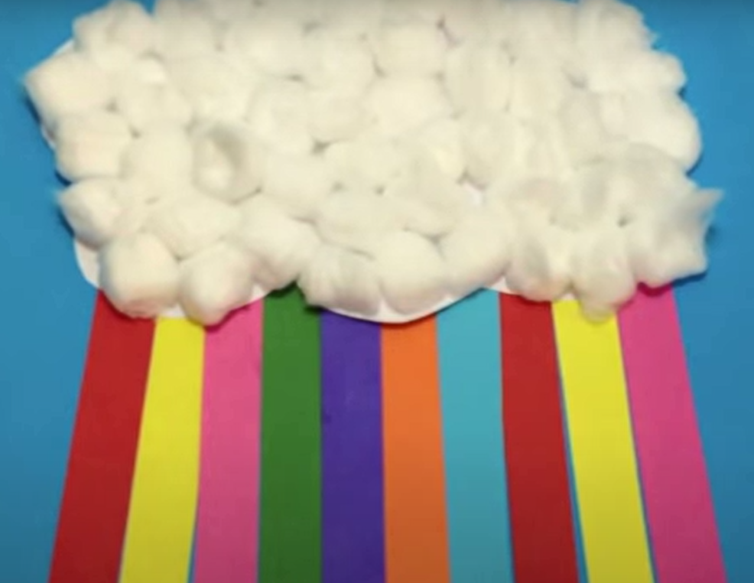
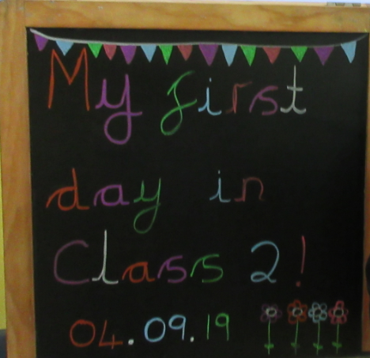
The year started off great,
In transition making personalised
rainbow clouds.
We knew then straight away,
That we would be proud.

Slide 3
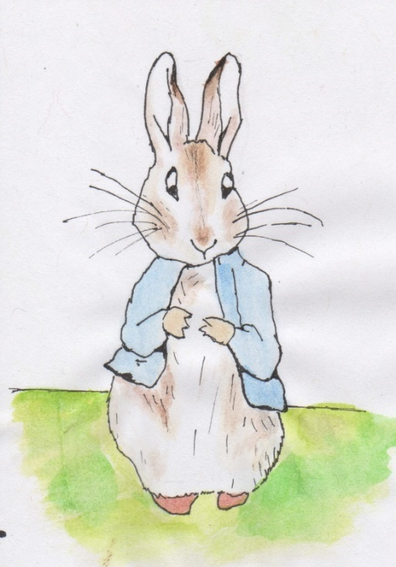
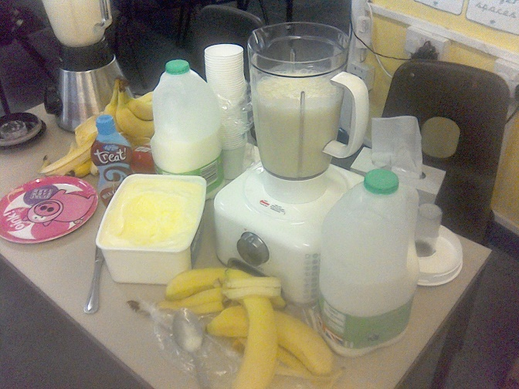
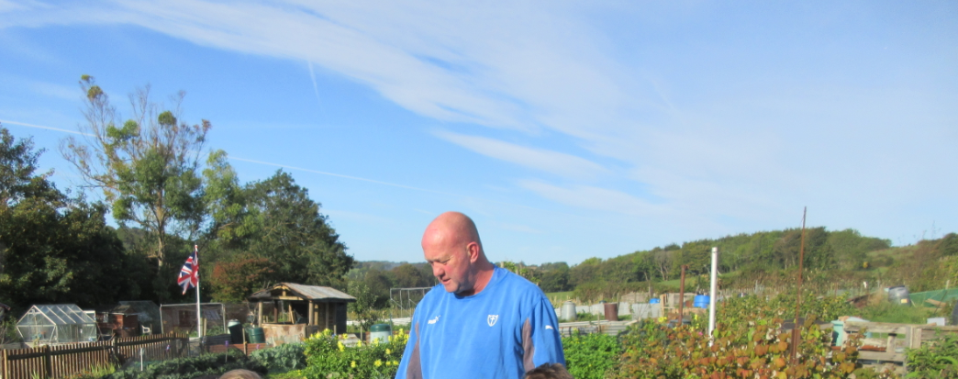
Our first topic was Peter Rabbit,
We re-told the story and created
water colour paintings,
We learned about where food comes
from and even made milkshakes,
We went to Mr Castle’s allotment on
the bus,
And each one of you became special
to us.

Slide 4
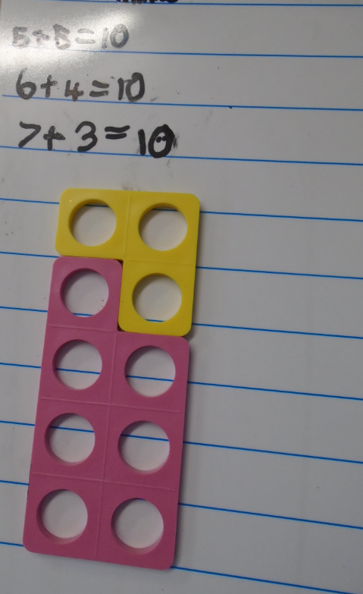
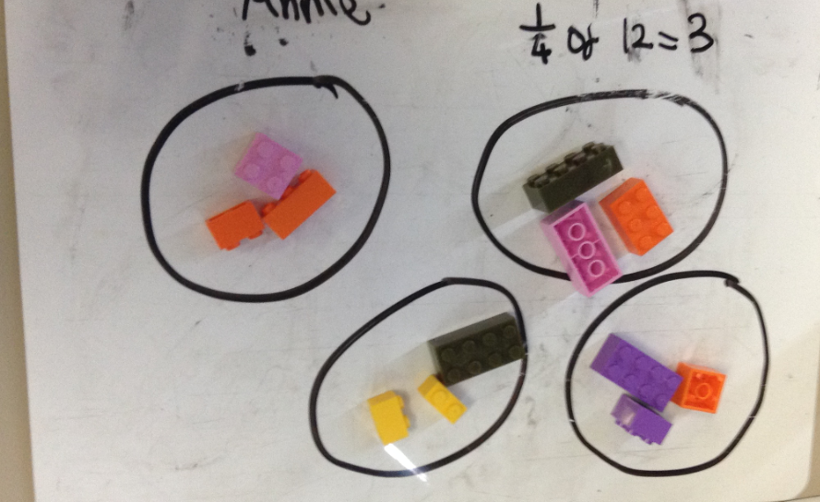
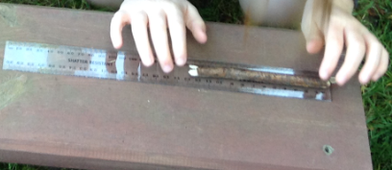
We watched you grow in confidence,
In maths, reading and writing,
You made everyday in Year 2,
More interesting and exciting.

Slide 5
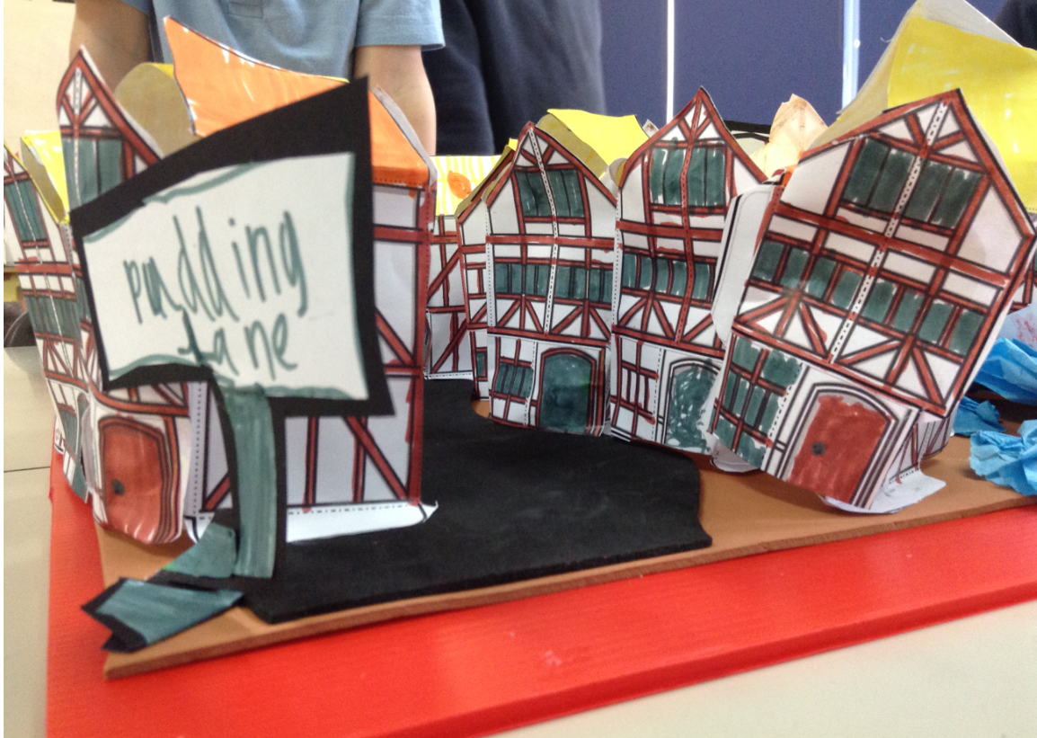
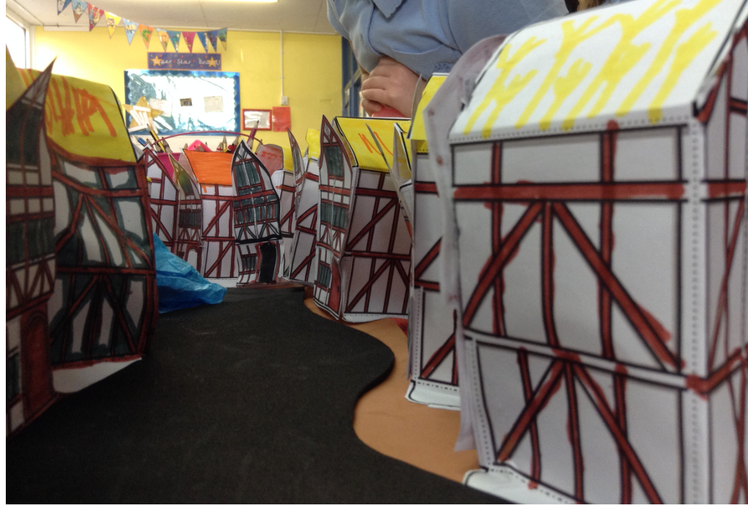
We learned about The Great Fire of
London,
And researched Samuel Pepy’s,
You deserve a huge well done!
As you created an amazing Pudding
Lane street.

Slide 6

Christmas was exciting,
Visits from Santa and the nativity!
Your singing was beautiful,
And your confidence great to see.

Slide 7
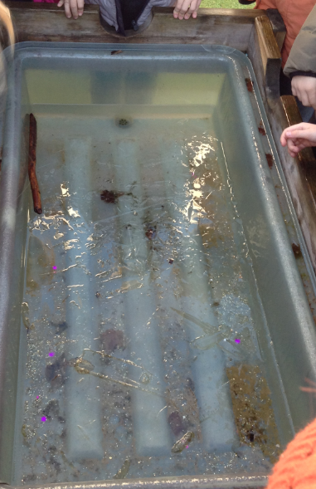
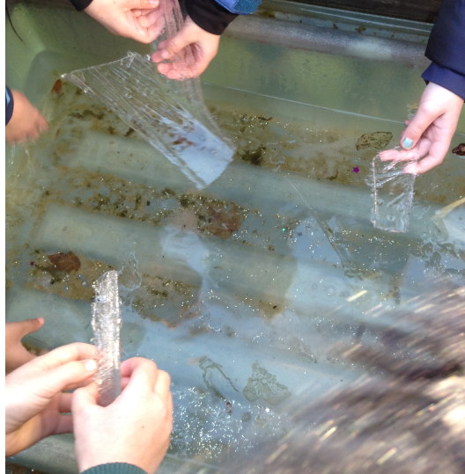
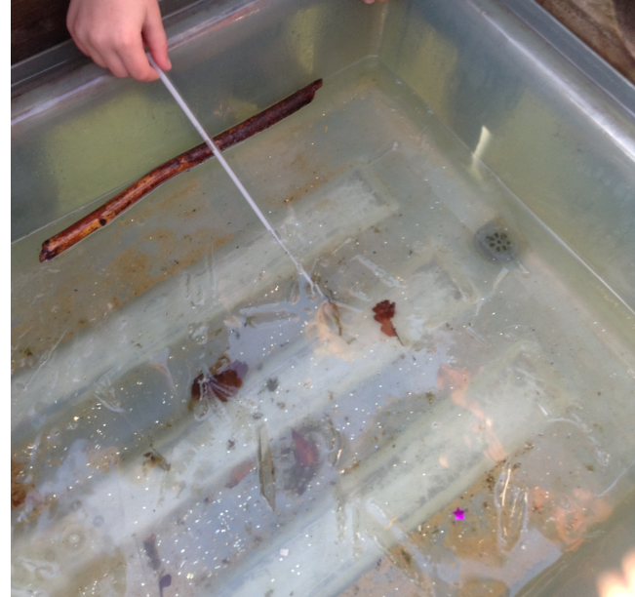
The weather became colder,
The water tray even turned to ice,
You became the best of friends,
Always being kind and nice.

Slide 8
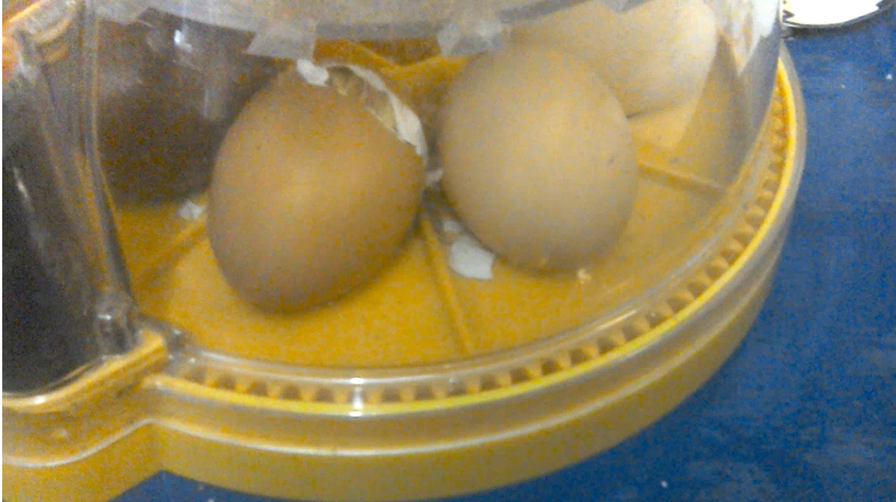
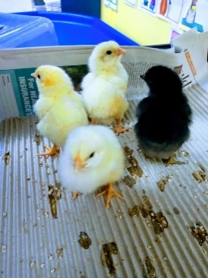
As the weather turned warmer,
We watched our beautiful chicks
hatch,
We named them Steve, Agent Chick,
Shelby and Billy,
The names you choose were an
interesting match!

Slide 9
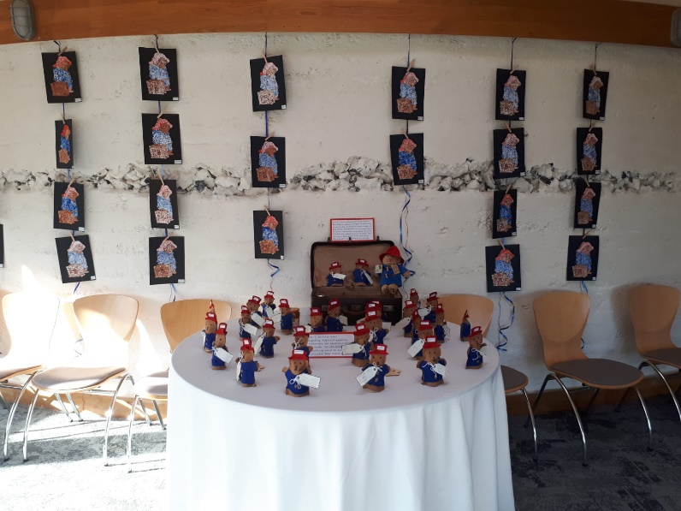
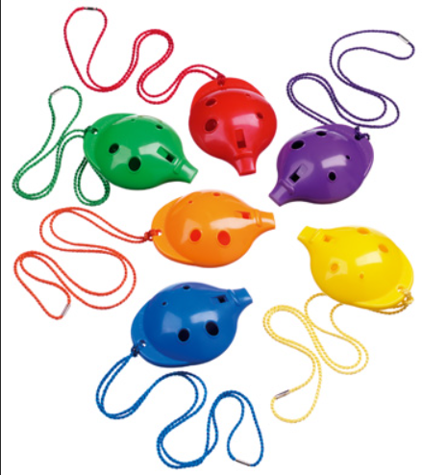
We learned about Paddington and
Peru,
We will never forget the Paddington
puppets you learned to sew.
Your ocarina skills were coming on
too!
But before we performed at our
Spring Concert,
Lockdown meant we had to say
goodbye to you.

Slide 10
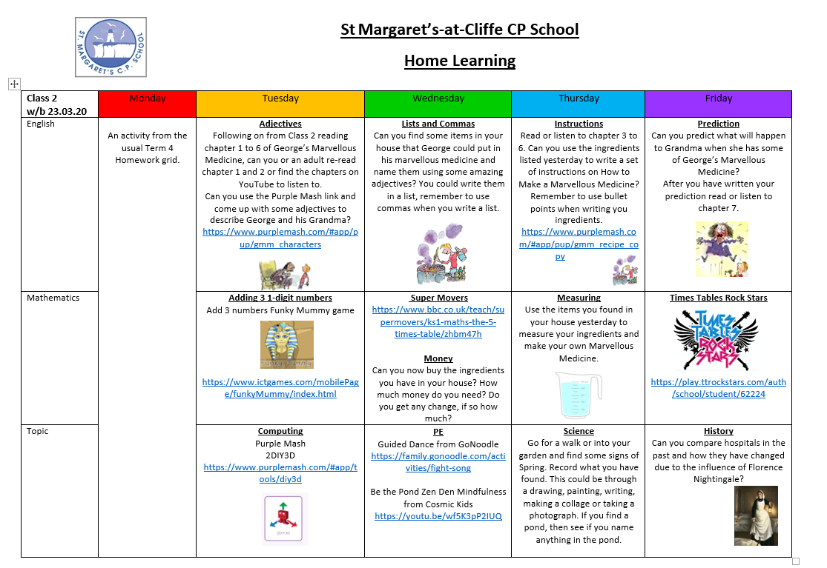
So we have all been learning from
home,
Working with our families online.
And although we’ve really missed
you,
We will be back to school in no time!

Slide 11
So although we didn’t get the full
year,
And year 2 was far too short,
We have cherished each and everyone
of you,
And will remember the happiness you
brought.

Slide 12

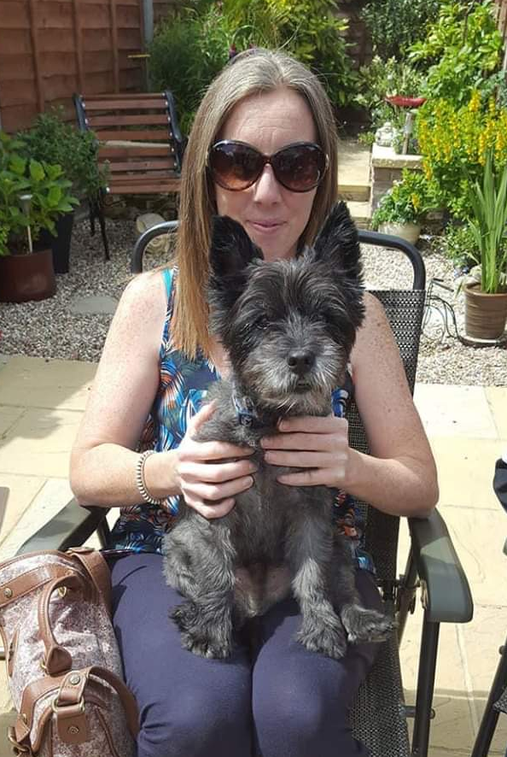
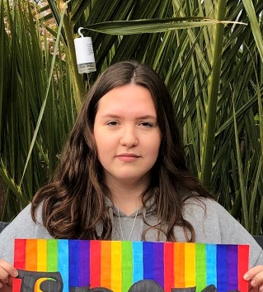
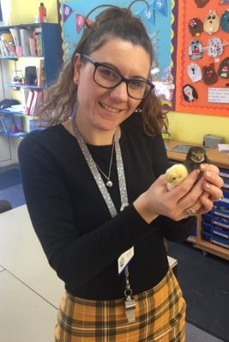
You will be amazing in year 3,
And as we move up with you,
We will continue to watch you grow.
You are our amazing lockdown Year
2 class,
And we are so proud, more than you
know!
Love From
Mrs Geere, Miss Harkins & Miss Walton

