Slide 1

Monday 18th January
WALT: recognise differences between living things and their offspring

Slide 2
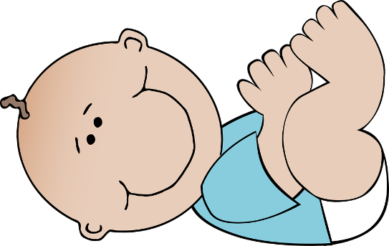
When living things have babies they are called their ‘offspring’.
What does ‘inherit’ mean?

Slide 3
Consider these questions:
Do all offspring inherit the same things?
Are all siblings of living things identical?
Watch this video

Slide 4

So there are lots of physical characteristics that can be inherited…
Think about these in animals…

Slide 5
Eye colour
Wing shape
Stinger size
Stripe thickness

Slide 6
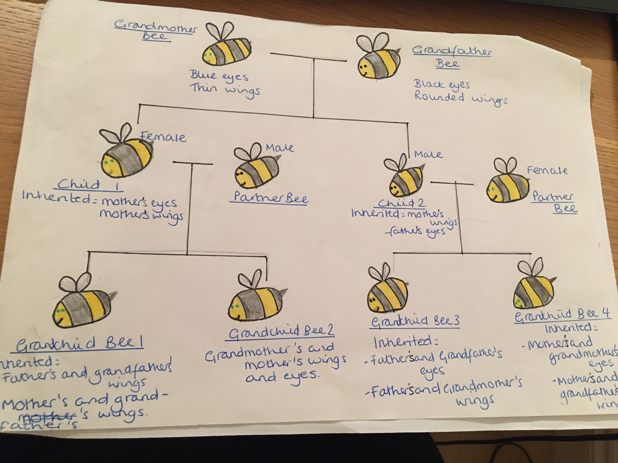

Slide 7
TASK:
Choose an animal and create its family tree – show some of the characteristics which have been inherited through the family.
Don’t forget to add labels to show which characteristics have been inherited and from whom. Can you show the differences between your chosen living thing and its offspring?
Please email this to me.

Slide 8
Next week we will be thinking about our own family trees!
You might like to begin collecting photos of family members…

